Slide 1
Opening the Network
to Less-Visible Histories
Catherine Quinlan
Dean of the USC Libraries
Hugh McHarg
Associate Dean for Strategic Initiatives

Slide 2
Why Catherine can’t be with us this year

Slide 3
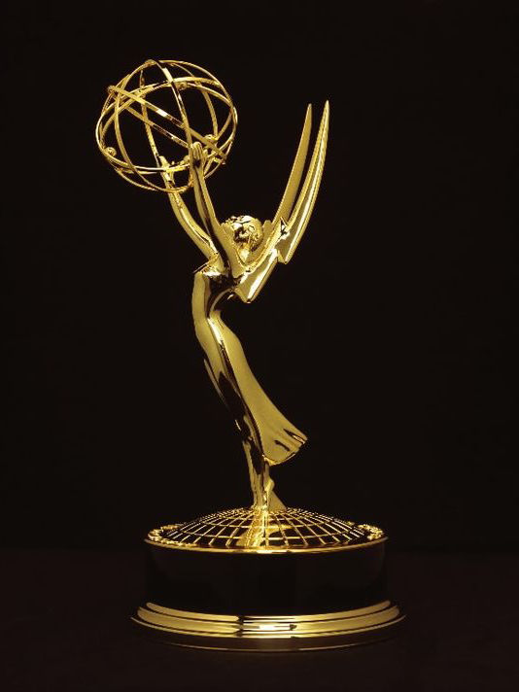

Slide 4
Outline
Strategic foundations
USC’s and the libraries’ strategic plans
Collections Convergence Initiative
Connecting less-visible histories
Southern California archives census
Los Angeles community collections
L.A. as Subject digital residencies

Slide 5
USC’s and the Libraries’ Strategic Plans
Leading through values
University
Leading through people
Leading through impact
https://bit.ly/2p2eGBC

Slide 6
USC’s and the Libraries’ Strategic Plans
Leading through values
Community, history
University
Leading through people
Inclusion, investment
Libraries
Leading through impact
Access, literacy, capacity
https://bit.ly/2p2eGBC
https://bit.ly/2MlL4IM

Slide 7
Collections Convergence Initiative
Disciplinary scholars and creative artists
Library curators and public programs
Collections
Led by a prominent scholar
Community of scholars, artists, archivists, and special collections librarians
Disciplinary scholars participate directly in collection development
Programming with fellows and postdocs
Areas of strategic importance for the university and the libraries

Slide 8
Collections Convergence Initiative
Holocaust, genocide, and migration studies
East Asian languages and cultures
Cinema, music, and cultural production
LGBTQ history and cultures
Southern California studies, including border regions
Professor Bill Deverell of USC history and the Huntington-USC Institute on California and the West serves as the inaugural director and the faculty lead for SoCal studies.
Library Journal article on the initiative’s launch: https://bit.ly/2CRo3hr.

Slide 9
Collections Convergence Initiative
Southern California studies, including border regions
Examples of how this area is driving academic programming, sponsored-project funding, and inclusive, community-based programs…

Slide 10
Funding Partners

Slide 11
Southern California Archives Census
L.A. as Subject
230 libraries, museums, archives, private collections
Surfacing “less-visible” histories fundamental to its charter
2020 marks its 25th birthday
Haven’t had a programmatic, region-wide, on-the-ground exploration of new collections since the 1990s
California State Library funding:
Archivist position to identify collections that support Southern California historical scholarship
An updated directory integrated with the L.A. as Subject web presence

Slide 12
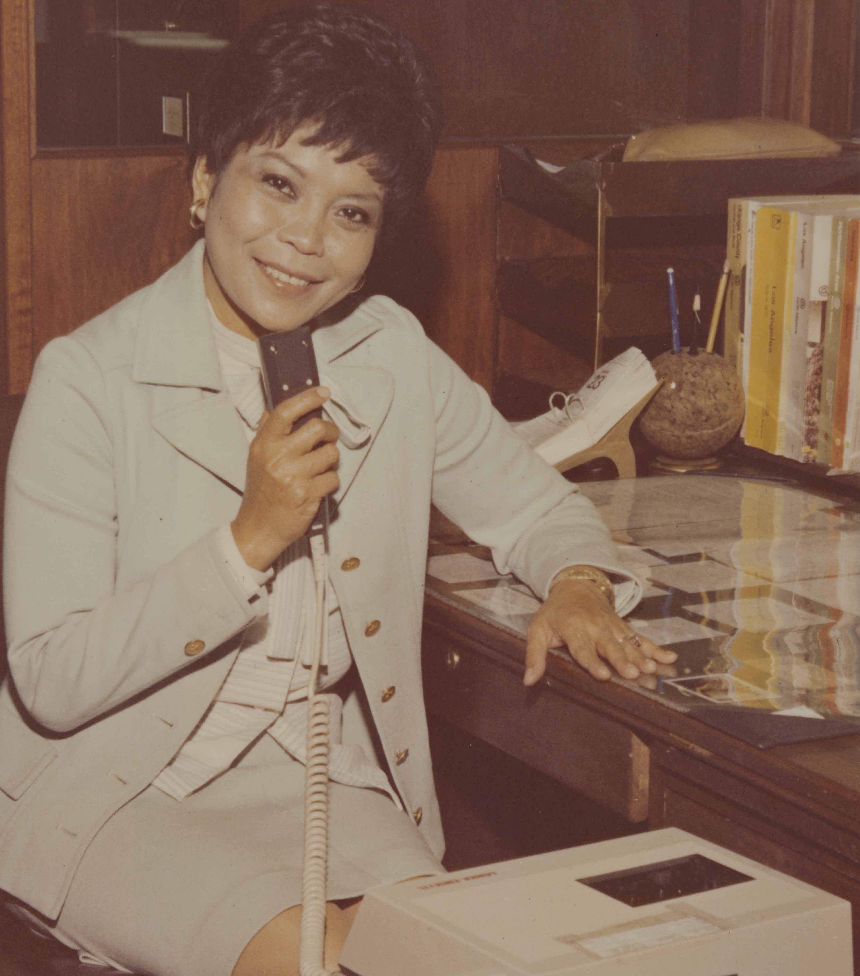
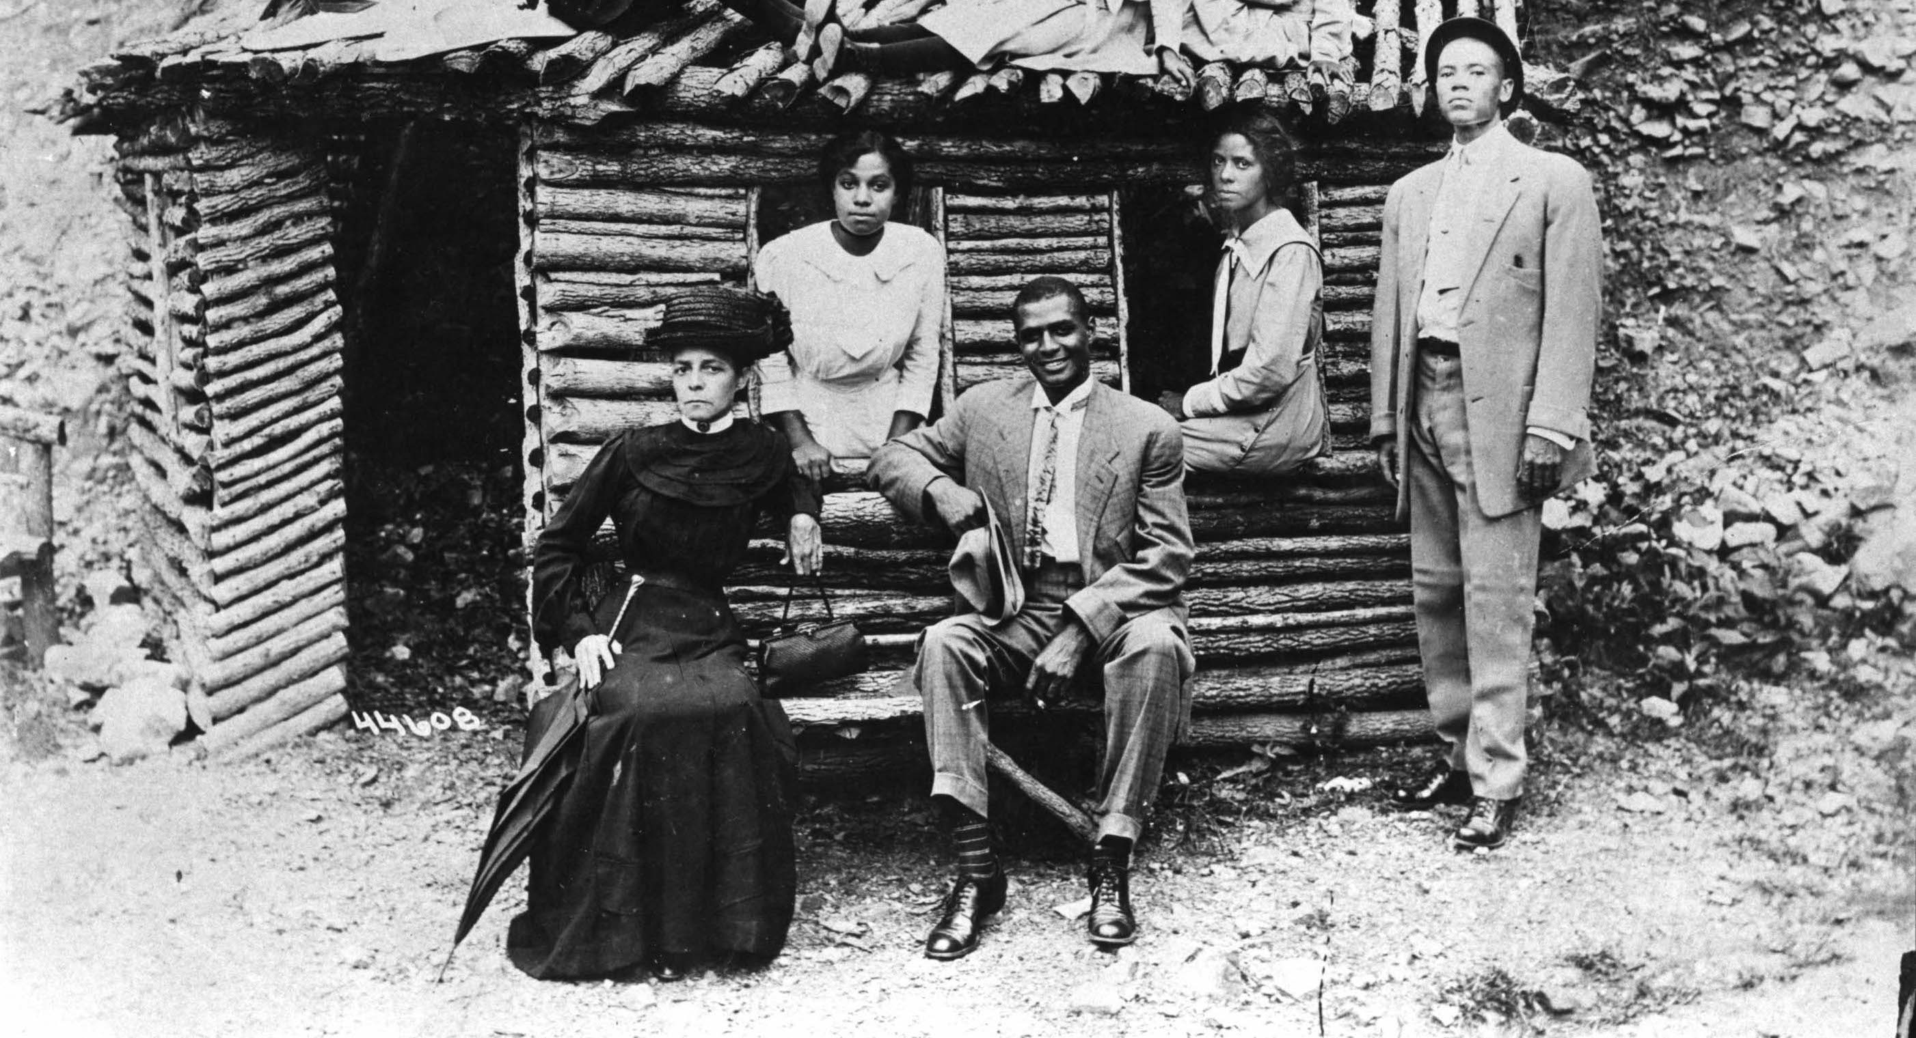
Los Angeles Community Collections
Bringing less-visible stories into the network means investment in digital capacity beyond large institutions
Identified and recruited L.A. as Subject members
Pasadena Museum of History, Filipino American Library, First African Methodist Episcopal Church, and others
Digitizing their collections and bringing them into established digital platforms at partner institutions
Had to convince funders of the national significance of these hidden histories
Funded by the National Endowment for the Humanities

Slide 13
L.A. as Subject Digital Residencies
Designed a program around 3 early-career archivists
Each will receive training beginning in May 2019
Librarianship mentoring
Archival practice
Digitization apprenticeships at USC, CSUN, CSUDH
Residencies at community archives to advance staff, librarian, and archivist training in digital methods throughout the L.A. as Subject network

Slide 14
L.A. as Subject Digital Residencies
By the completion date in 2021, the program will have:
Placed residents at 10 community archives
Digitized Los Angeles-related collections at those organizations and made them discoverable through the USC Digital Library and digital libraries at CSUN and CSUDH
Trained 150 librarians, archivists, and other staff throughout the L.A. as Subject membership
Funded by Institute of Museum and Library Services

Slide 15
3-Program Totals
At least 25 libraries, archives, museums, and private collections
Tom & Ethel Bradley Center, California African American Museum, California State University Los Angeles’ East L.A. collections, Campo de Cahuenga, Compton 125 Historical Society, Glendale Public Library Arts & Culture Department, the Historical Society of Long Beach, the Japanese American National Museum, the Los Angeles Police Museum, Pasadena Museum of History, Rancho Dominguez Adobe, the San Fernando Valley Historical Society, the San Gabriel Mission Playhouse, San Pedro Bay Historical Society, the Tradeswomen Archives, J. Michael Walker—creator of the All the Saints of the City of the Angels project, Filipino American Library, the First African Methodist Episcopal Church of Los Angeles, the Go for Broke National Education Center, the Pasadena Museum of History, the Southern California Library, and the Workman and Temple Family Homestead Museum, CSUDH, CSUN, USC

Slide 16
3-Program Totals
180+ librarians, archivists, digitization specialists and other staff members
IMLS program: PI Marje Schuetze-Coburn of the USC Libraries; co-PIs Ellen Jarosz of the Oviatt Library at CSUN, Rachel Mandell of the USC Libraries, and Greg Williams of Gerth Archives and Special Collections at CSUDH; Thomas Philo of CSUDH; Steve Kutay of CSUN; Deborah Holmes-Wong, Giao Luong Baker, Liza Posas, Tim Stanton, and Claude Zachary of the USC Libraries; consultants Marianne Afifi and Cindy Mediavilla; and Marva Felchlin, formerly of the Autry Museum of the American West; NEH program: Co-PIs Susan Luftschein and Giao Luong Baker, Zahid Rafique, Wayne Shoaf, Louise Smith, and Timothy Stanton of the USC Libraries and Nick Street of the Center for Religion and Civic Culture at USC Dornsife College; Florante Ibanez of the Filipino American Library; the pastor and leadership at First AME Church; archivist Gavin Do of Go for Broke National Education Center; archivist Anuja Navare of the Pasadena Museum of History; staff at the Southern California Library; and Paul Spitzzeri and Michelle Muro Villarreal of the Workman & Temple Family Homestead Museum; 150 trainees at participating archives

Slide 17
Questions
hmcharg@usc.edu
https://libraries.usc.edu
https://www.kcet.org/shows/lost-la

