Slide 1
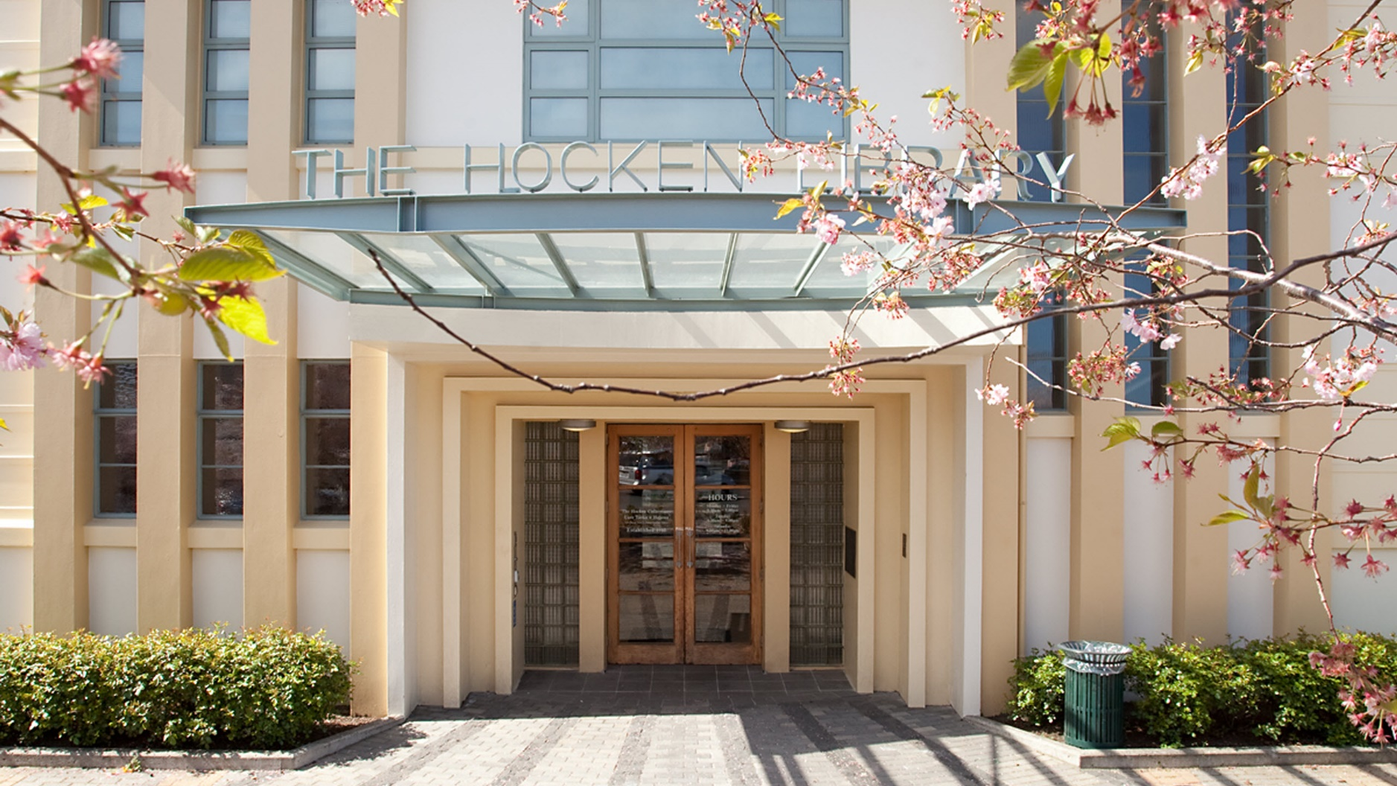

Slide 2
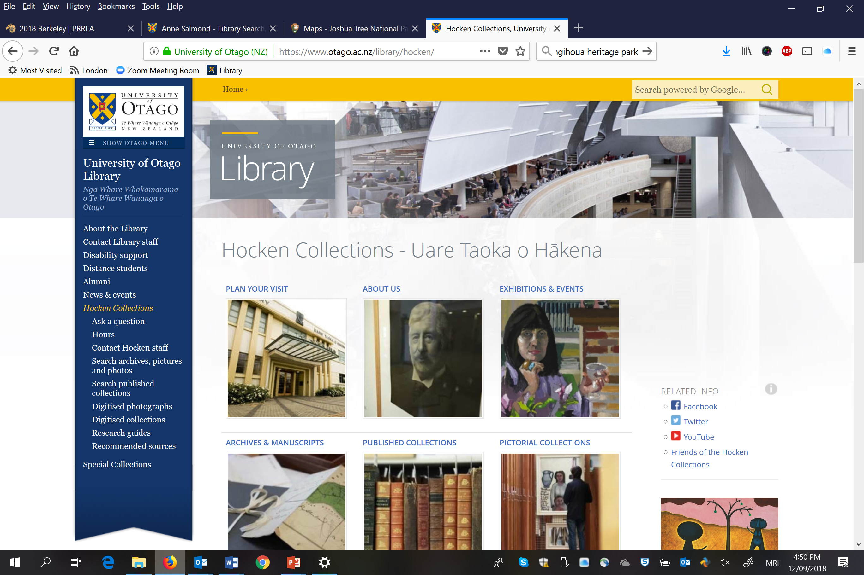
Twitter versed?

Slide 3
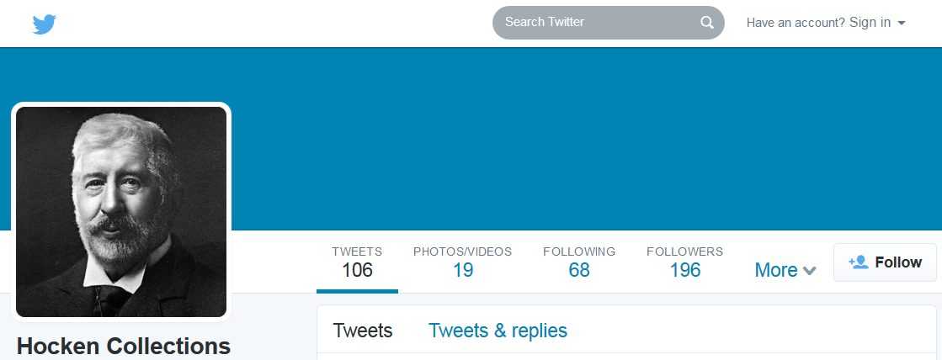
Twitter versed?
Follow Hocken Collections @DocHocken
Check out the Hocken Blog https://blogs.otago.ac.nz/thehockenblog/

Slide 4
Rev. Samuel Marsden, James Fitler, n.d.
Hocken Collections Te Uare Tāoka o Hakena acc: 23, 602

Slide 5
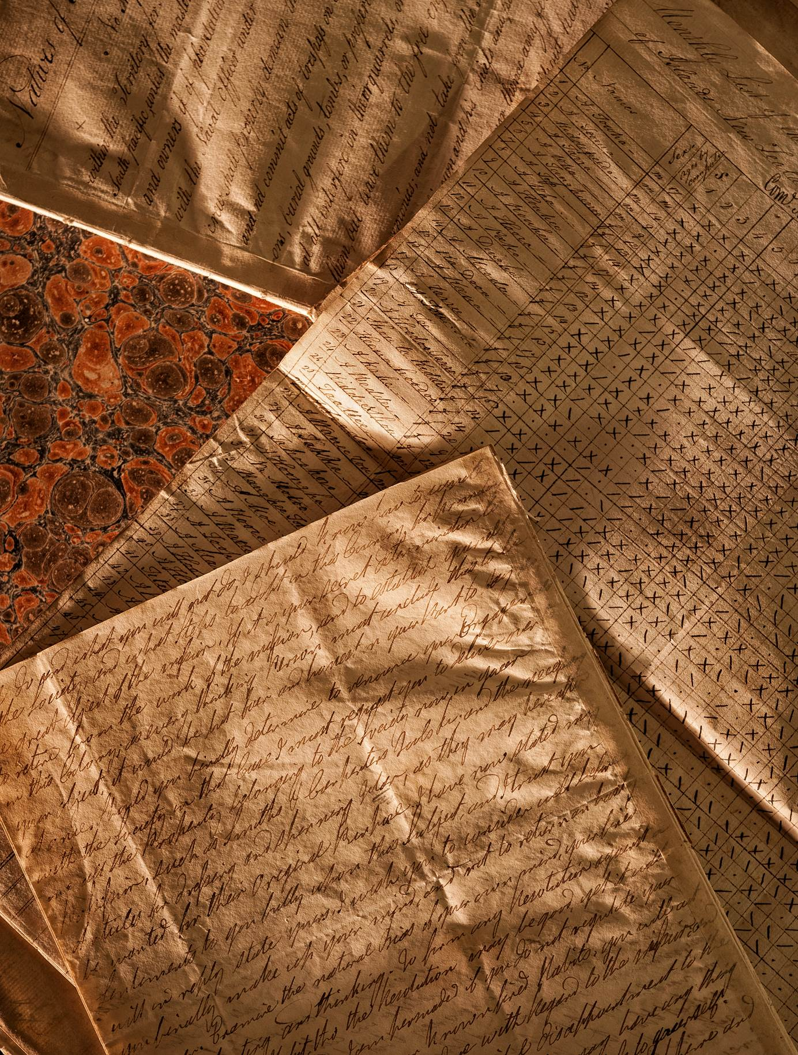
Roll from the mission school at Rangihoua in February 1816, and other documents from the Marsden papers.
Hocken Collections Te Uare Tāoka o Hakena ARC-0001

Slide 6
https://marsdenarchive.otago.ac.nz/

Slide 8
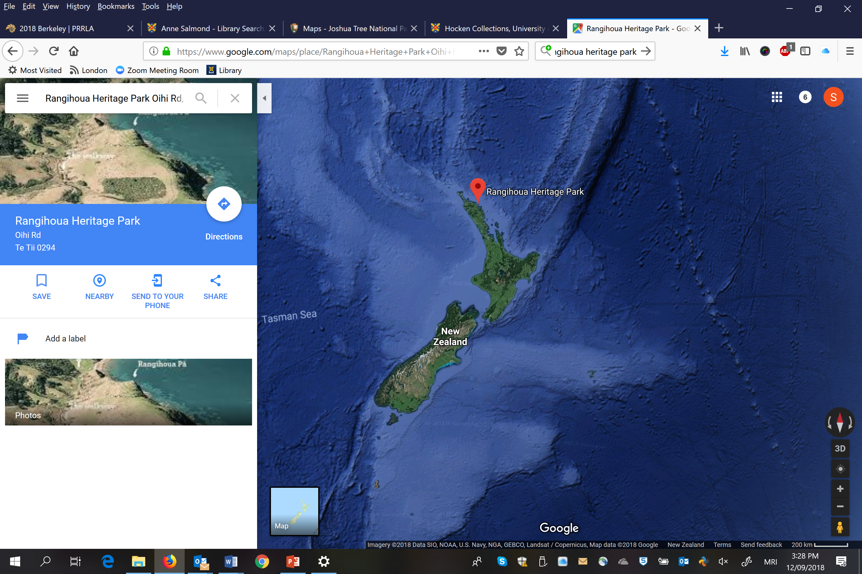

Slide 9
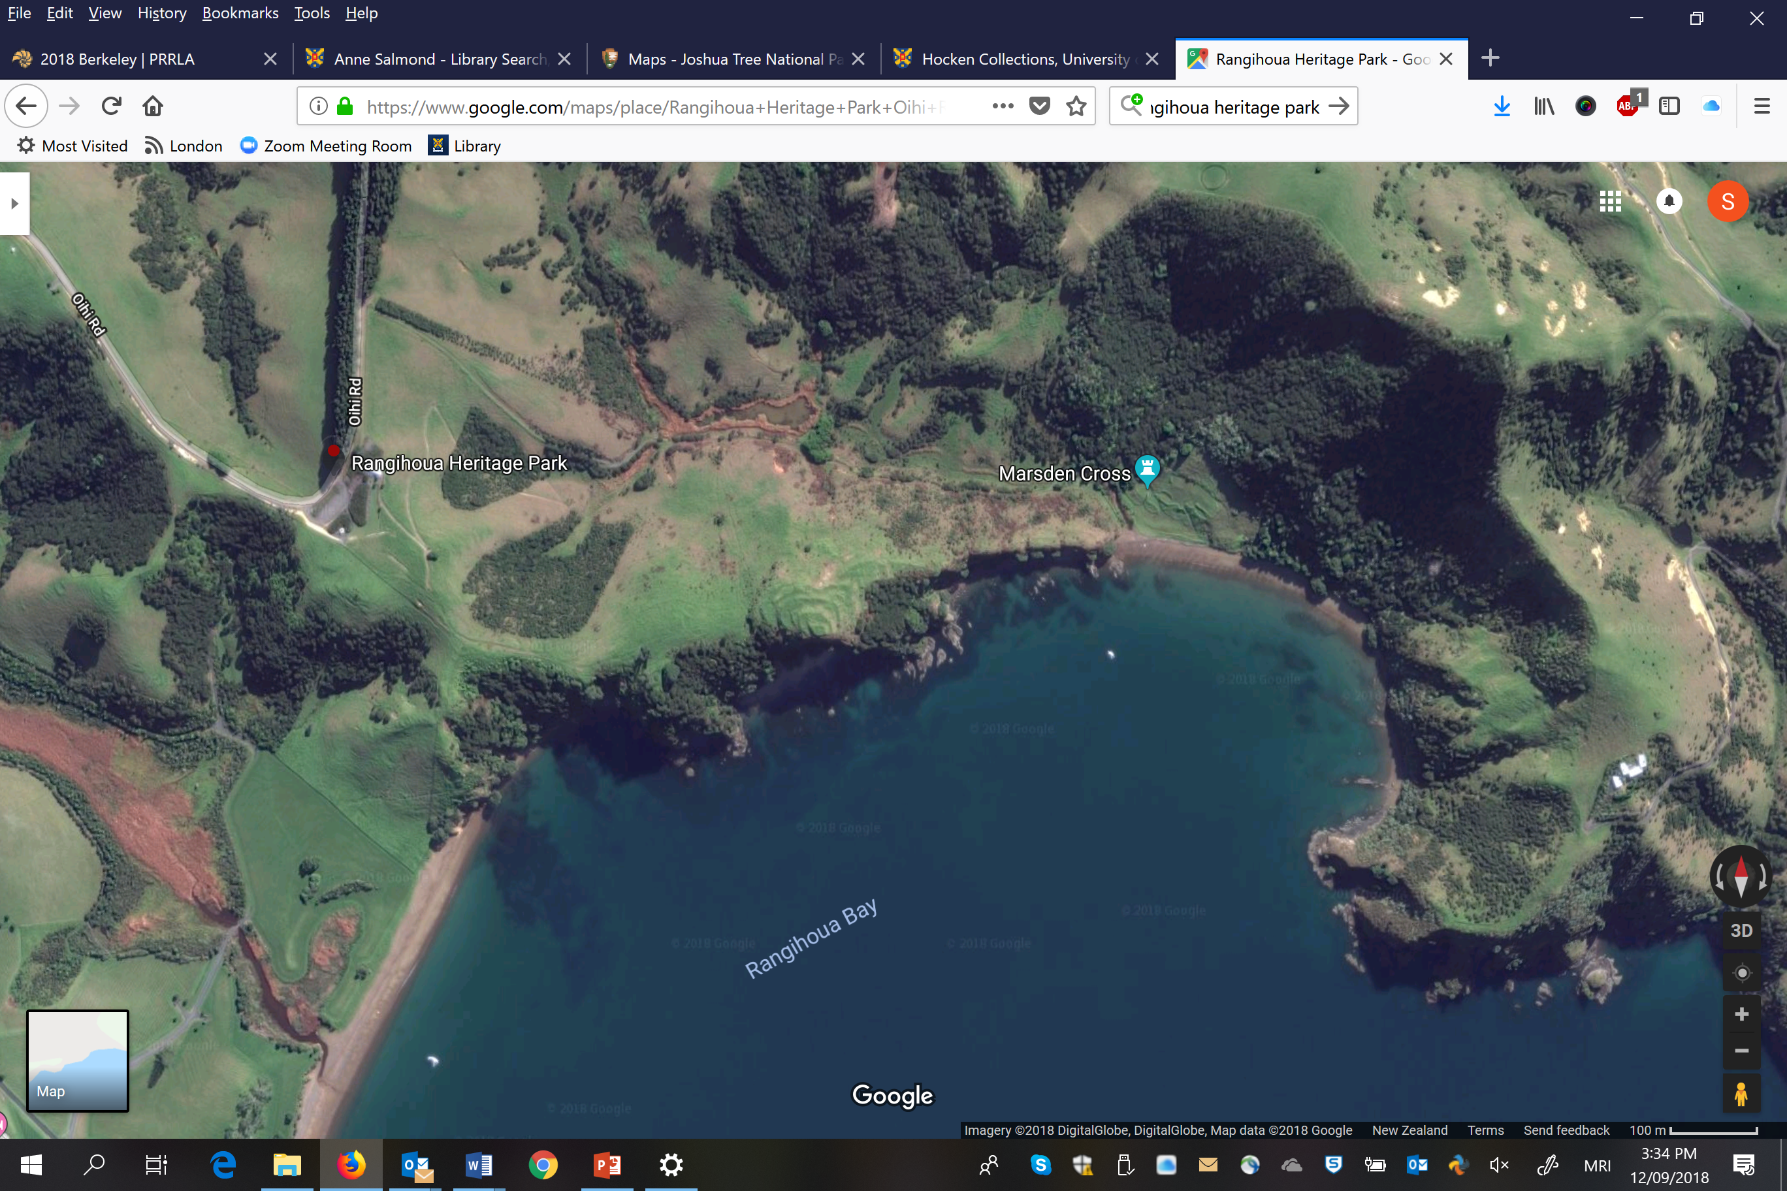

Slide 10
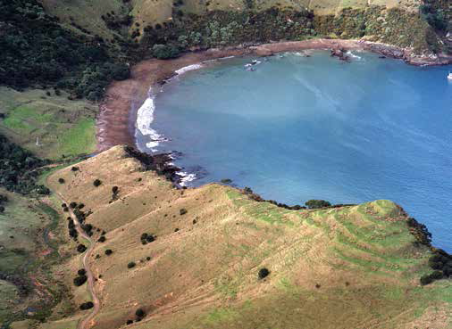
Ian Smith, Department of Archaeology and Anthropology, University of Otago

Slide 11
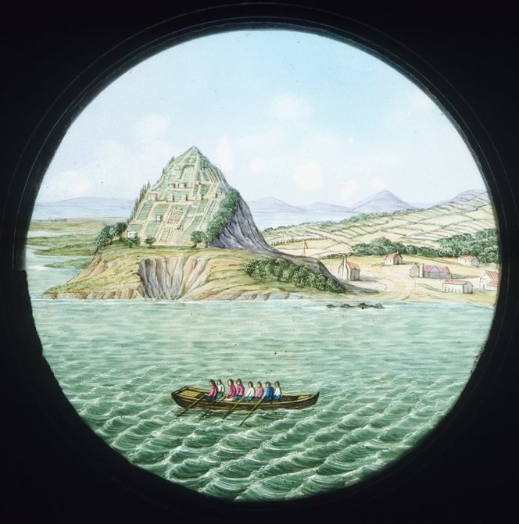
Setting the scene – RANGIHOUA PA
Record Title | : | Artist unknown Rangihoa [sic], New Zealand / London, W. E. & F. Newton [Between 1852 and 1857]
Reference Number | : | Curios-021-008
Physical Description | : | Hand-coloured glass, 80 mm diameter (sight), in wooden frame 101 x 165 mm.
Quantity | : | 1 curio(s)
Scope and Contents | : | Shows missionary settlement at Rangihoua, Bay of Islands.
Other Notes | : | After an almost identical image (which however has 2 larger sailing ships in the foreground) "Church missionary settlement at Rangihoua, N.Z.", published in Church Missionary Quarterly Papers, midsummer 1832, no. 66, cover page; and, "[Missionary settlement at Rangihoua on the North side of the Bay of Islands c.1830]", an oil painting in the Rex Nan Kivell collection. This latter also features two vessels in foreground sea. Dating: the firm W E & F Newton (stamped on the wooden frame) was based at 3 Fleet Street from 1852 to 1857
Provenance | : | Purchased from Mrs Carole Brackenbury, Bulls, in 1989.
Restrictions | : | Unrestricted
Issue Status | : | Issuable ITEM
Digital Copy | : | Digital copy available
Copy Negative | : | Copy Negative (1/2-023024-F)
File Print | : | File Print (In Drawings & Prints under Artist/Title ; DFP-004606)
Colour Transparency | : | Colour Transparency (DCT-03481)

Slide 12
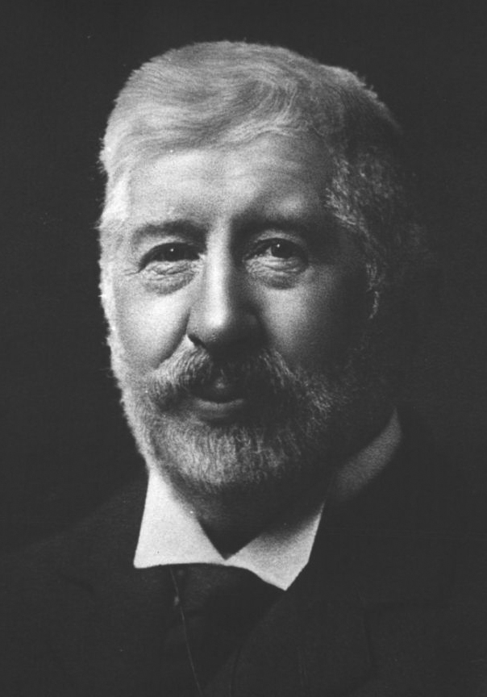
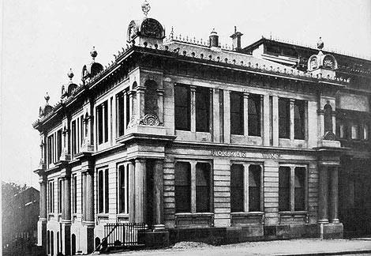
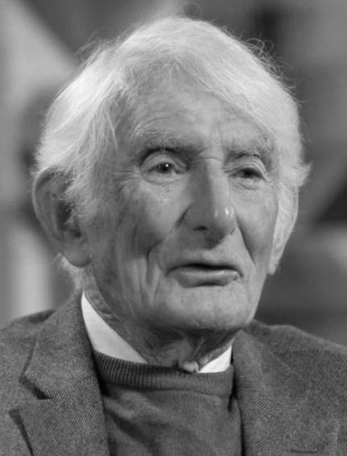
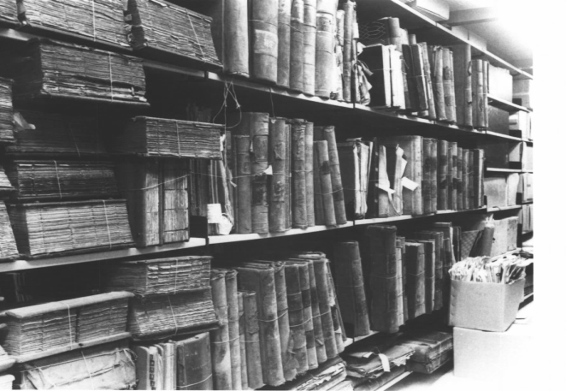
Recognizing Samuel Marsden The Significance of Marsden’s accounts for New Zealanders
Dr Thomas Morland Hocken
Retired Associate Professor Gordon Parsonson
Notes:
Dr. Hocken, the founder of Hocken Collections, came across Marsden's letters and journals when he visited the offices of the Church Missionary Society in London, between 1901-1904.
Realising their significance for New Zealanders, he somehow managed to secure these materials, and they now form part of the Hocken’s foundation collection, here in Dunedin.
Not well-known that Hocken has the material – not covered in the AJCP microfilming project.
In 1951, a young history student named Gordon Parsonson found himself accidently locked in the stacks of the Hocken Archives. Not wanting to cause a fuss, he pulled a volume off the shelf to read until someone let him out. The volume that he’d pulled out from the stacks just happened to be Marsden’s first journal, and he sat there reading it, until 5 o’clock when the Archives closed.

Slide 13
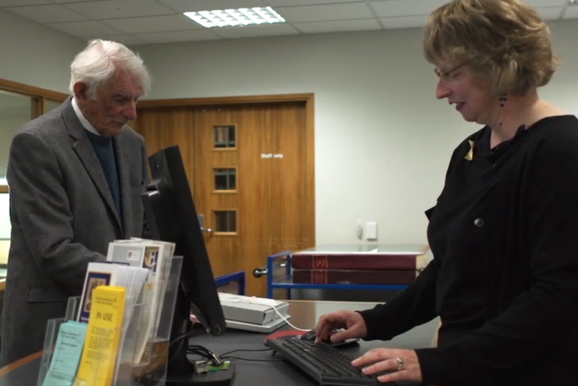
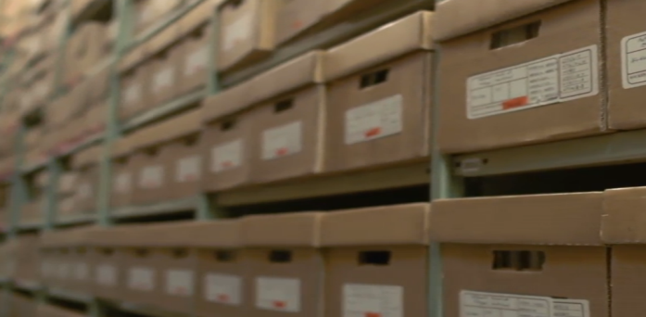
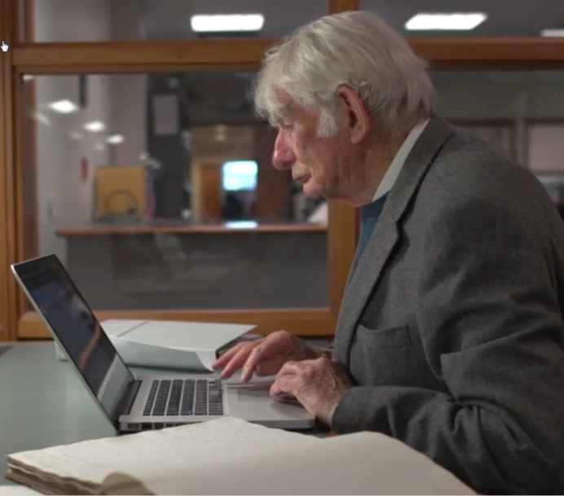
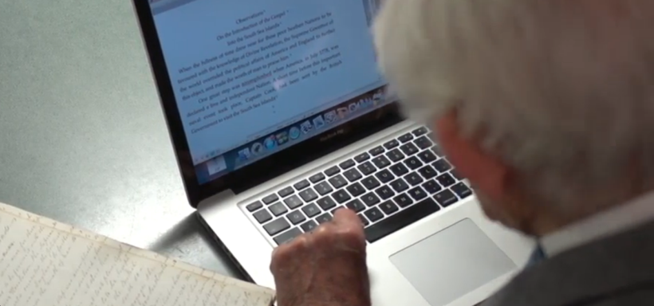
Gordon Parsonson Has generously made his transcripts available
Notes:
Ever since then, Gordon has painstakingly worked for over five decades to transcribe the letters and journals of Samuel Marsden and the other missionaries.
His generosity in sharing these transcriptions mean that they are so much more accessible to those who cannot read nineteenth century handwriting. Made the project possible because we already had digital text.

Slide 14
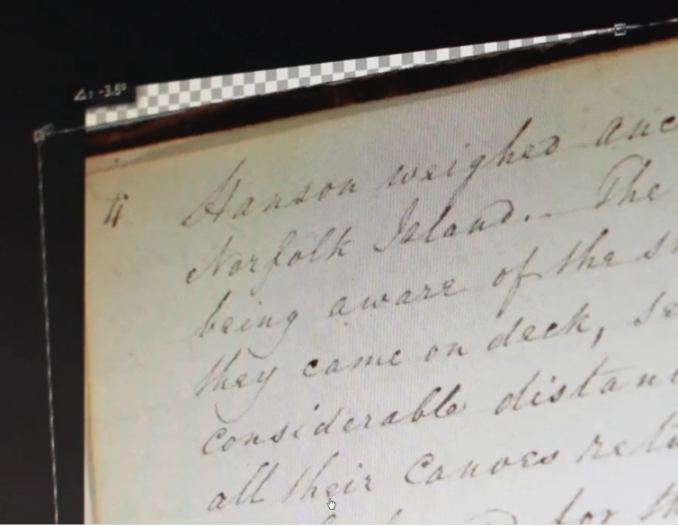
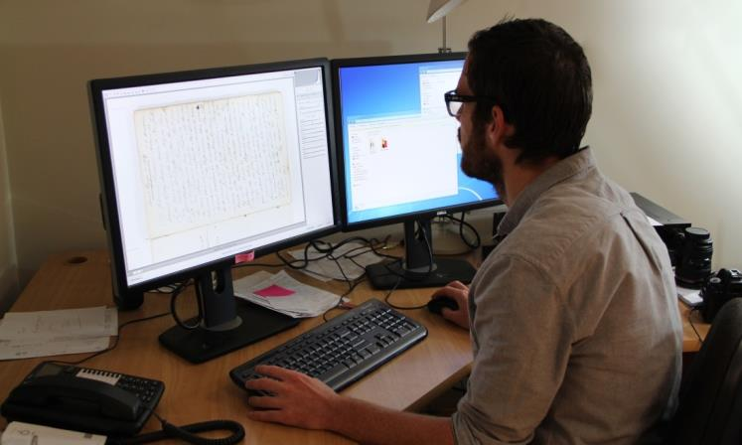
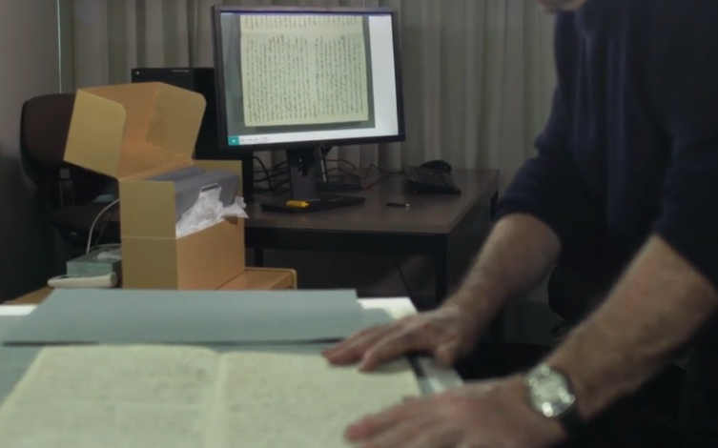
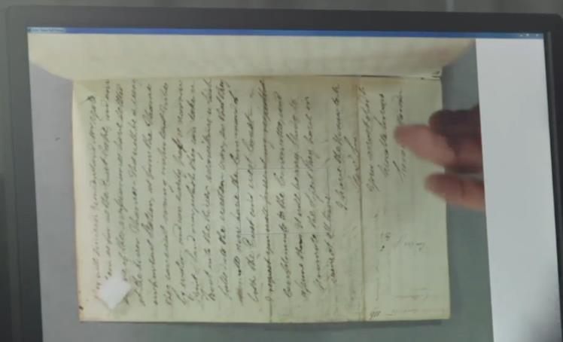
Digitising the Manuscripts Capturing, Rotating, Cropping 3,728 Images…
Notes:
The digitisation of the manuscripts required a camera (rather than a scanner), because of the fragile nature of the manuscripts.
This project required capturing 3,728 images and took 5 ½ months to complete (around other projects and Business as Usual).
Having a ‘live view’ on the monitor (as seen on this slide) made the process easier and ensured that the images were straight so they required less cropping.
Colour reflecting back onto the images was a problem, so unfortunately, Richard and John had to avoid wearing any psycholodelic shirts while capturing the images!
They could do batch jobs to rename the files, correct colour, boost the text, and get the image looking as close to the original as possible, but cropping and straightening of the images had to be done one-by-one.

Slide 15
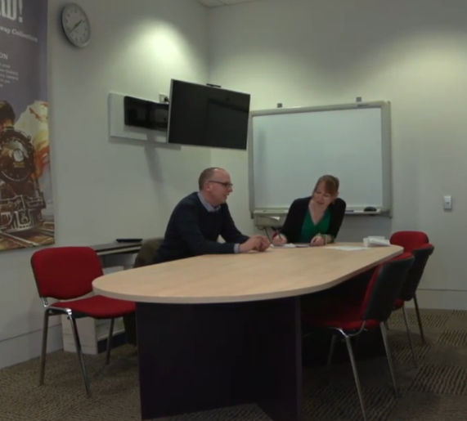
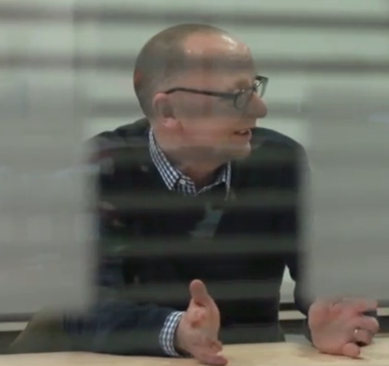
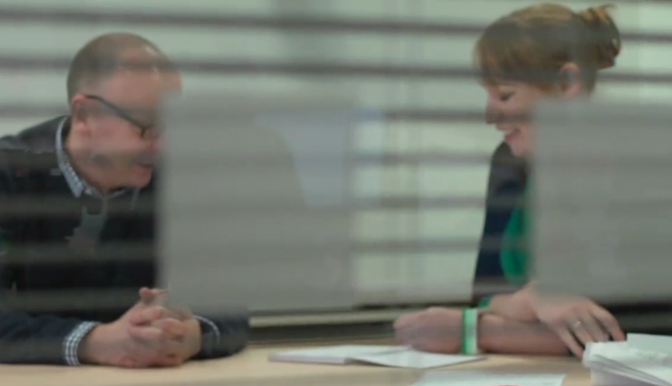
Capturing Researcher’s Requirements
Documenting the Required Interface Functionality
Notes:
Meanwhile, one of the University library liasion librarians responsible for the humanities was responsible for determining the researchers’ requirements for the interface.
That is, I needed to find out how they wanted to be able to view the material, the sort of search functionality that they would need, and the search filters that we’d need to set up to help them to refine their searches, and so on. This often involved showing them examples of functionality that was available on other sites, and asking if they’d find it useful (they always said ‘yes’).
So, the project manager and I met with several researchers from Otago, from other institutions, and also postgraduate students.
We also talked to people from other institutions who had been working on similar digital collections. Developed a list of about 43 requirements

Slide 16
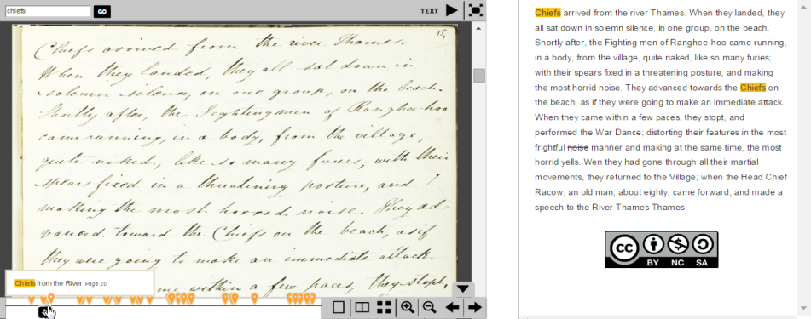
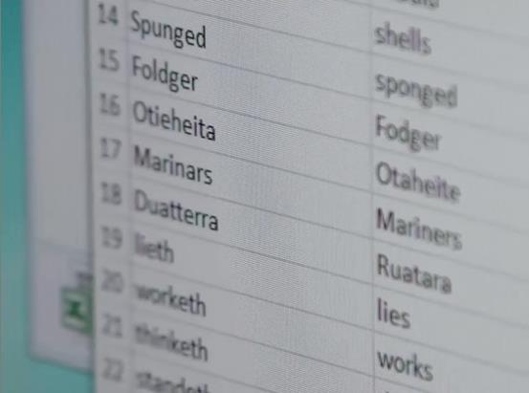
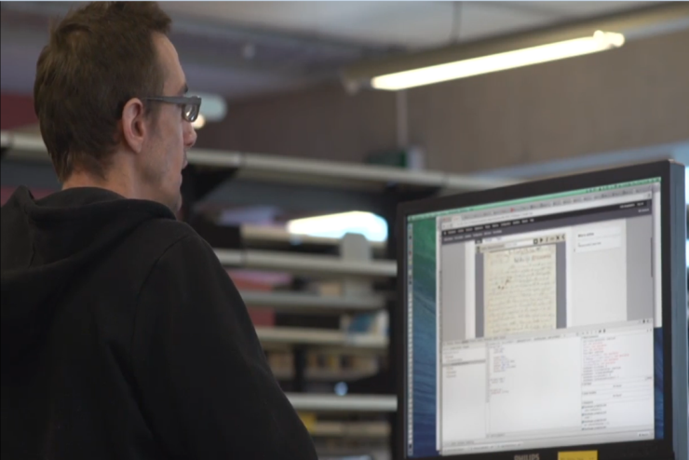
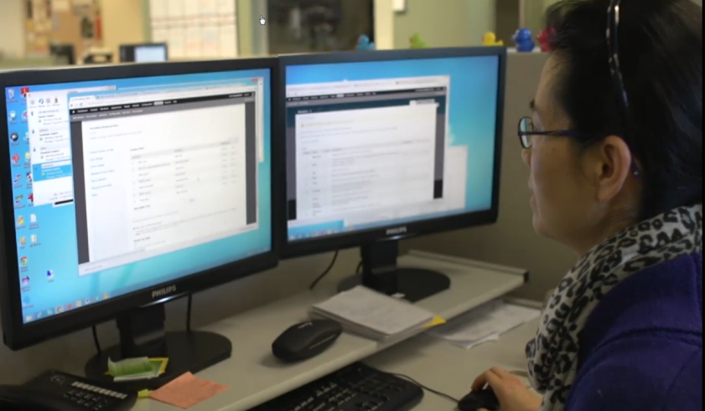
Meeting the Researcher Requirements Customising the Software to meet researchers needs
Notes:
The development team included 4 library staff in all (Hailing Situ, Emmanuel Delaborde [de-la-board], Shahne Rodgers and Allison Brown).
Each member of the team put together pieces of the puzzle.
A lot of customisation of the software was needed, in order to meet as many of the researchers requirements as possible.
For example, researchers wanted to be able to display the transcript and manuscript side by side, so they could read both simultaneously. This involved some big changes to the code.
Another example of the extended functionality that had to be created, is the highlighting of search terms. This alone took a week of full time development effort to customise, and was difficult, but well worth the time, because it helps researchers to identify where their search terms are appearing.
Researchers told us that the archive would need to allow for alternative spellings, as some words have changed significantly over the past 200 years. This is particularly true of Maori words, as these were historically spelt out phonetically. This was done by creating a ‘master list’ of words that were spelt incorrectly, and then manually adding in the correct spellings. Although this was a significant amount of effort, it is extremely valuable because it meant that the Archive could bring back results, even if the user had typed in the modern day spelling.

Slide 17
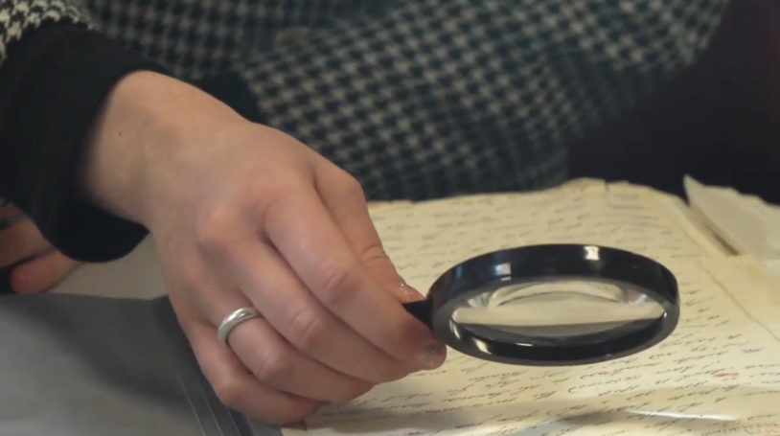
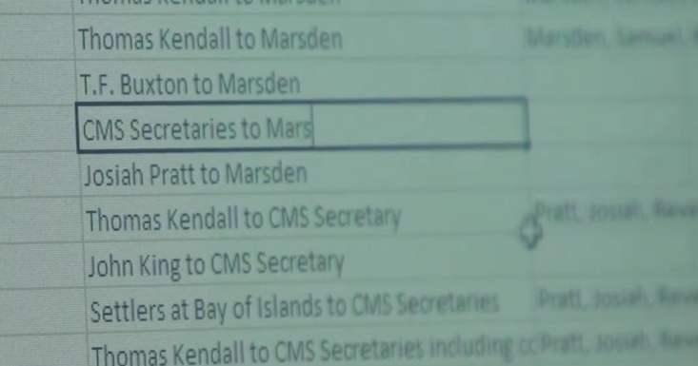
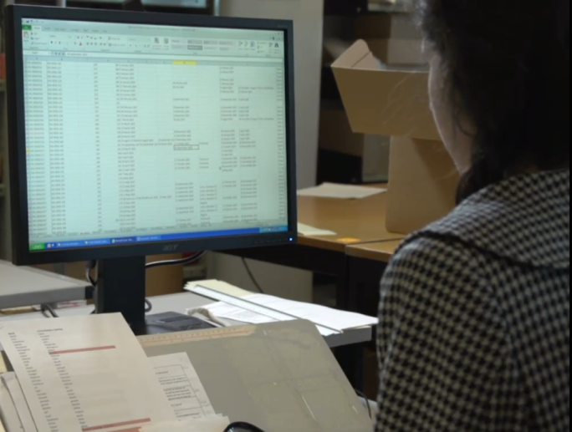
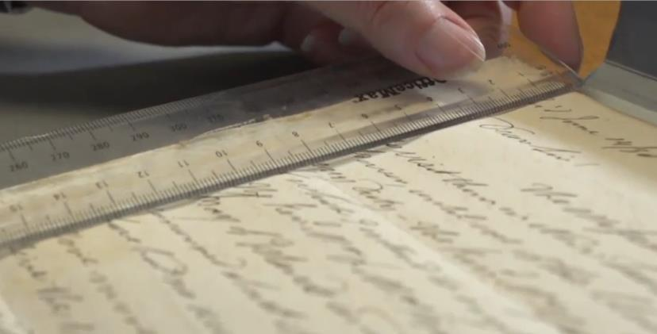
Capturing Additional Metadata
The Sender, Recipient, dimensions…
Notes:
Hands up if you know what I mean by ‘Metadata’.
Well, Metadata is basically just ‘data about data’ or ‘information about things’.
Unfortunately, we were missing some of the metadata that we’d need for researchers to be able to use the Archive in the ways that they wanted.
For example, researchers wanted to be able to search by the name of the ship that letters travelled on, and the dates that letters were sent and received, because it took months for letters to travel to England and for the missionaries to receive replies.
Gordon had not captured this information in his work but it was something that the researcher requirements identified as useful.
So staff gathered this missing metadata, along with the measurements of each document – to give researchers an idea of the size of each document, because it is hard to tell when you are viewing something on the screen.

Slide 21
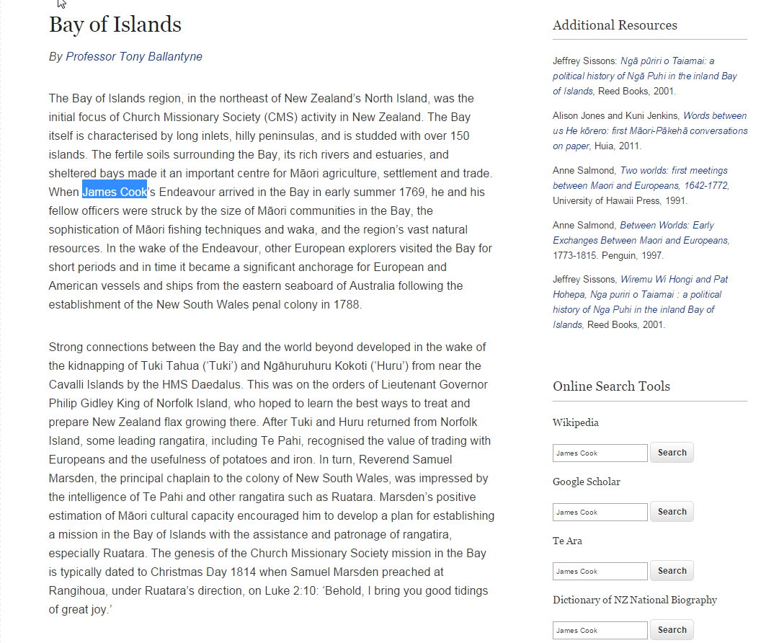

Slide 23
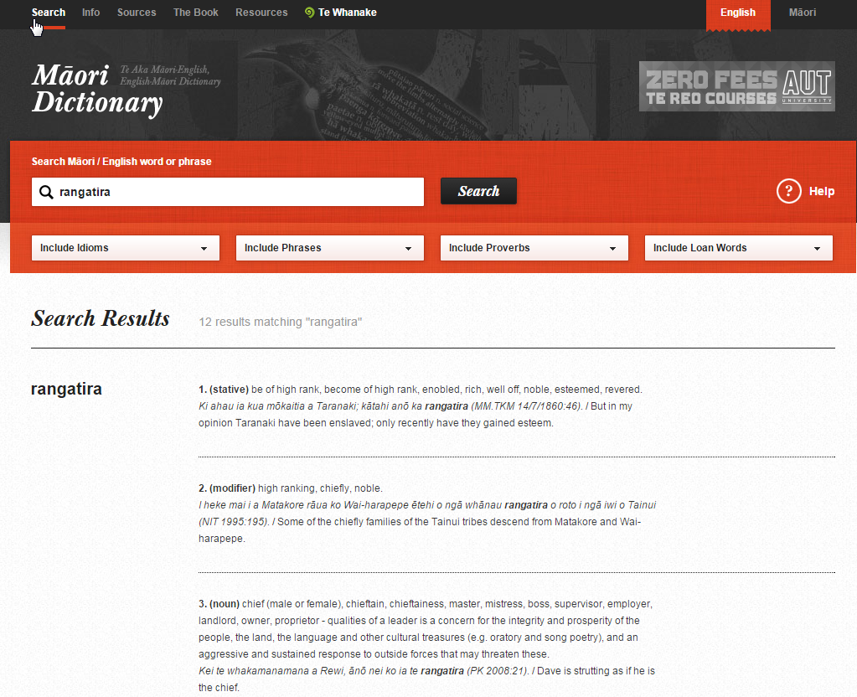

Slide 25
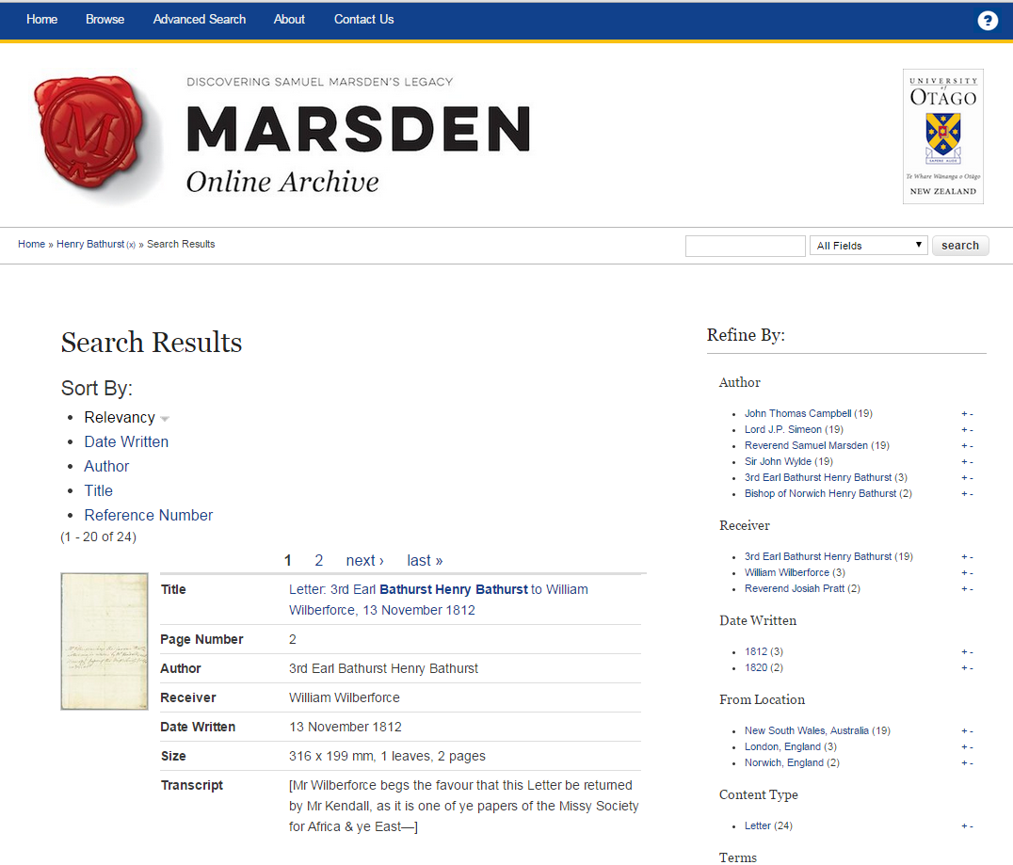

Slide 26
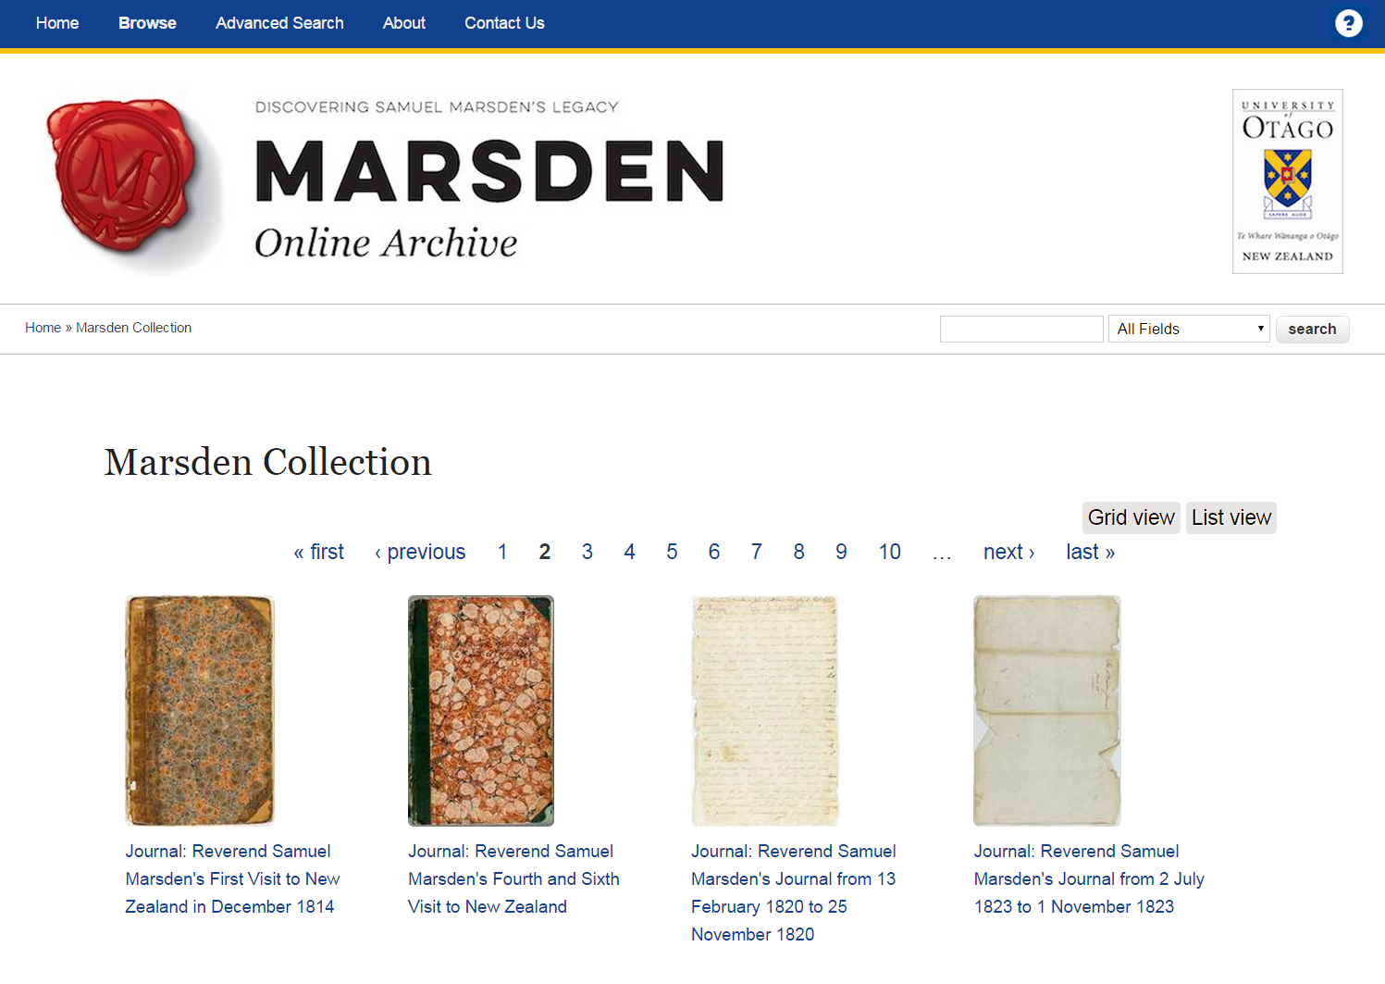

Slide 27
Notes:
.

Slide 28
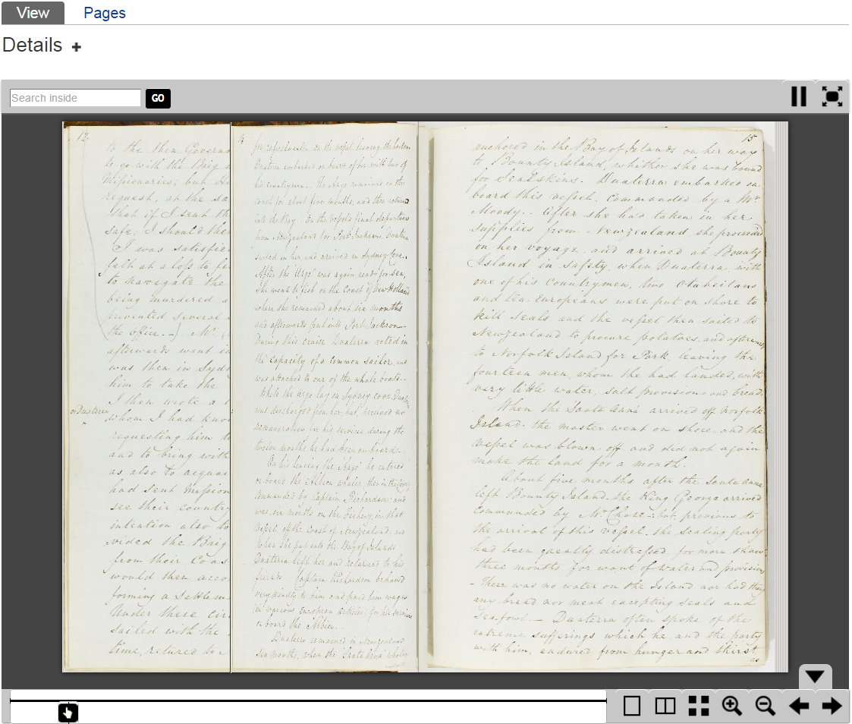

Slide 30
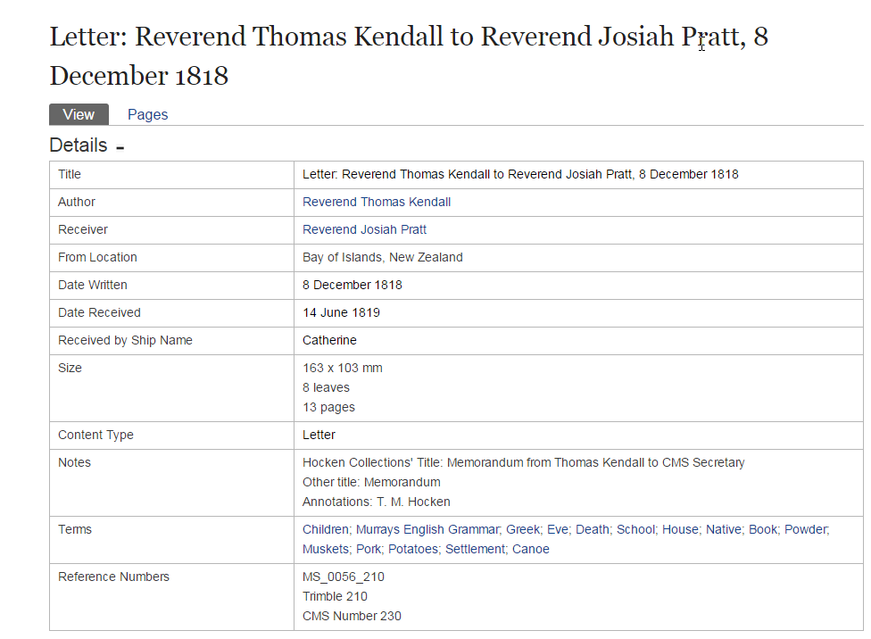

Slide 31
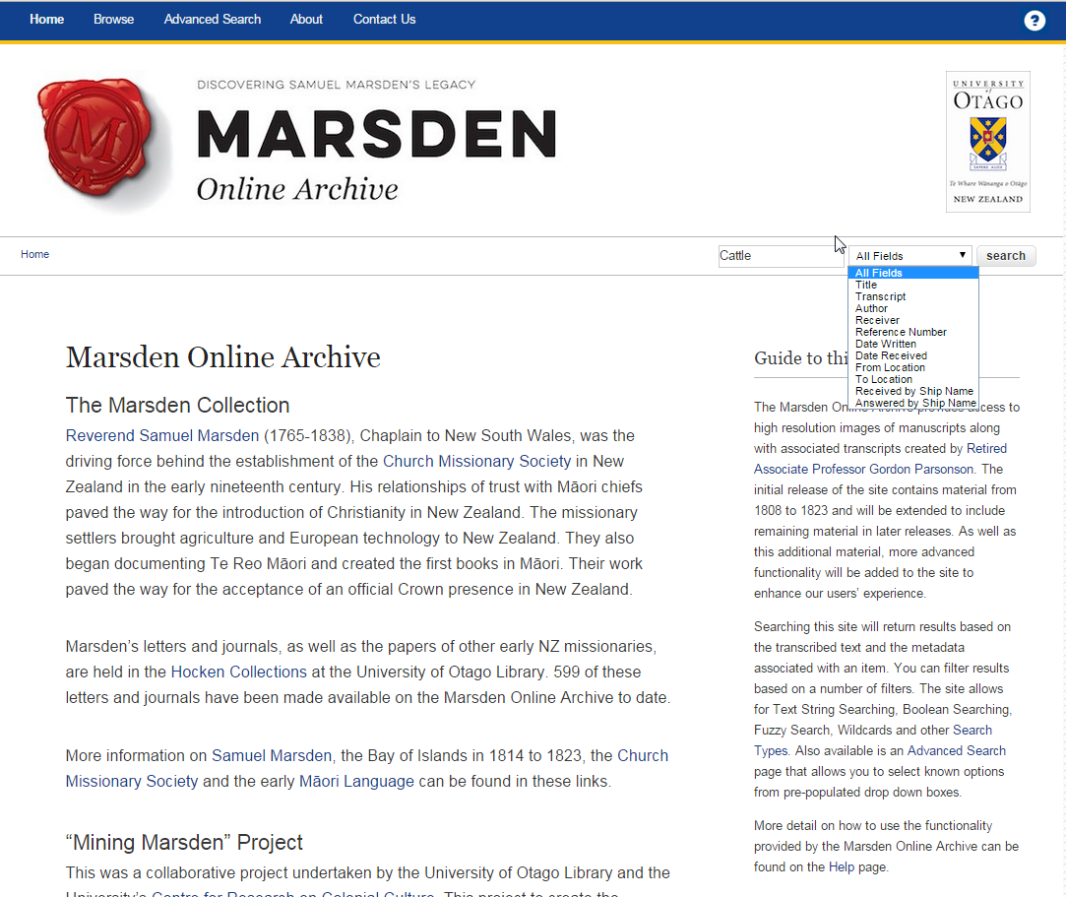

Slide 32
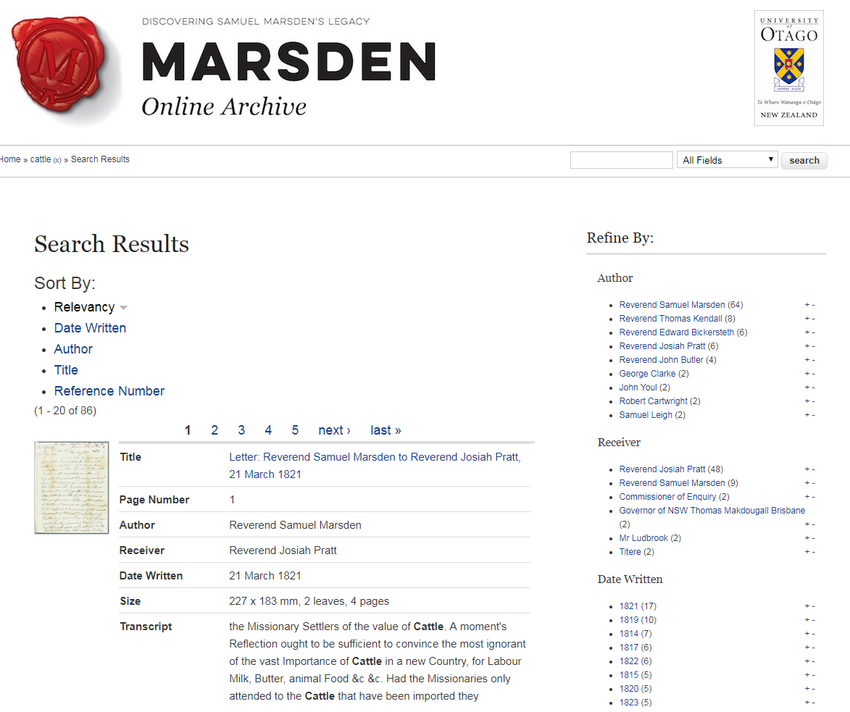

Slide 35
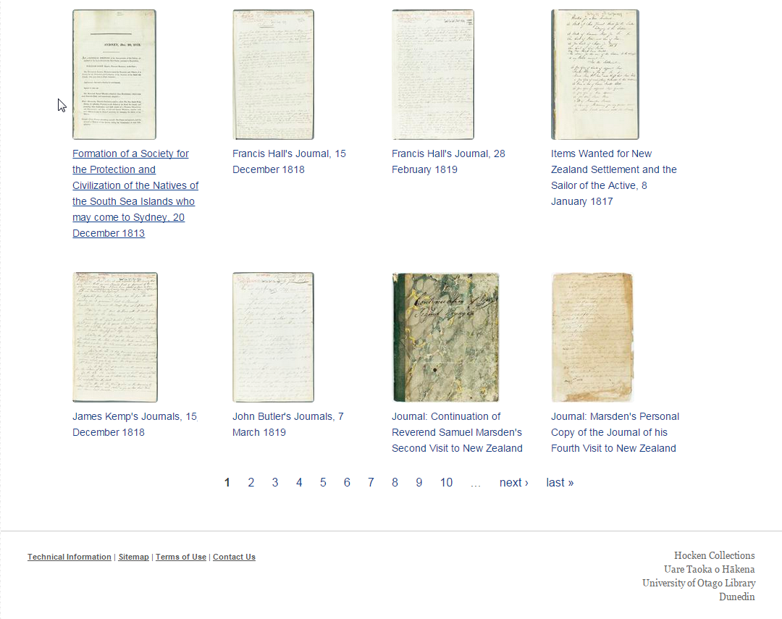

Slide 37
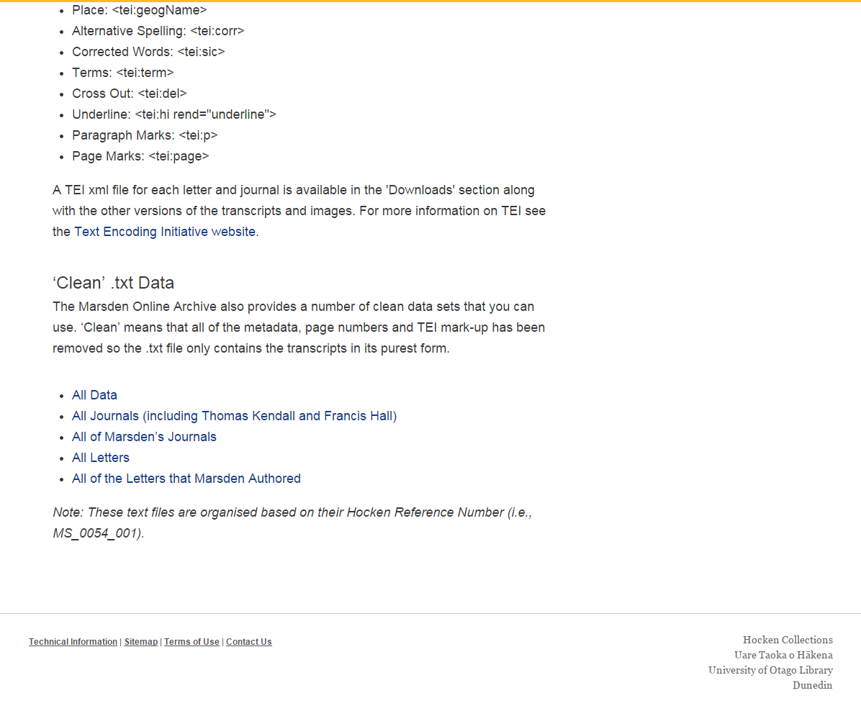

Slide 38
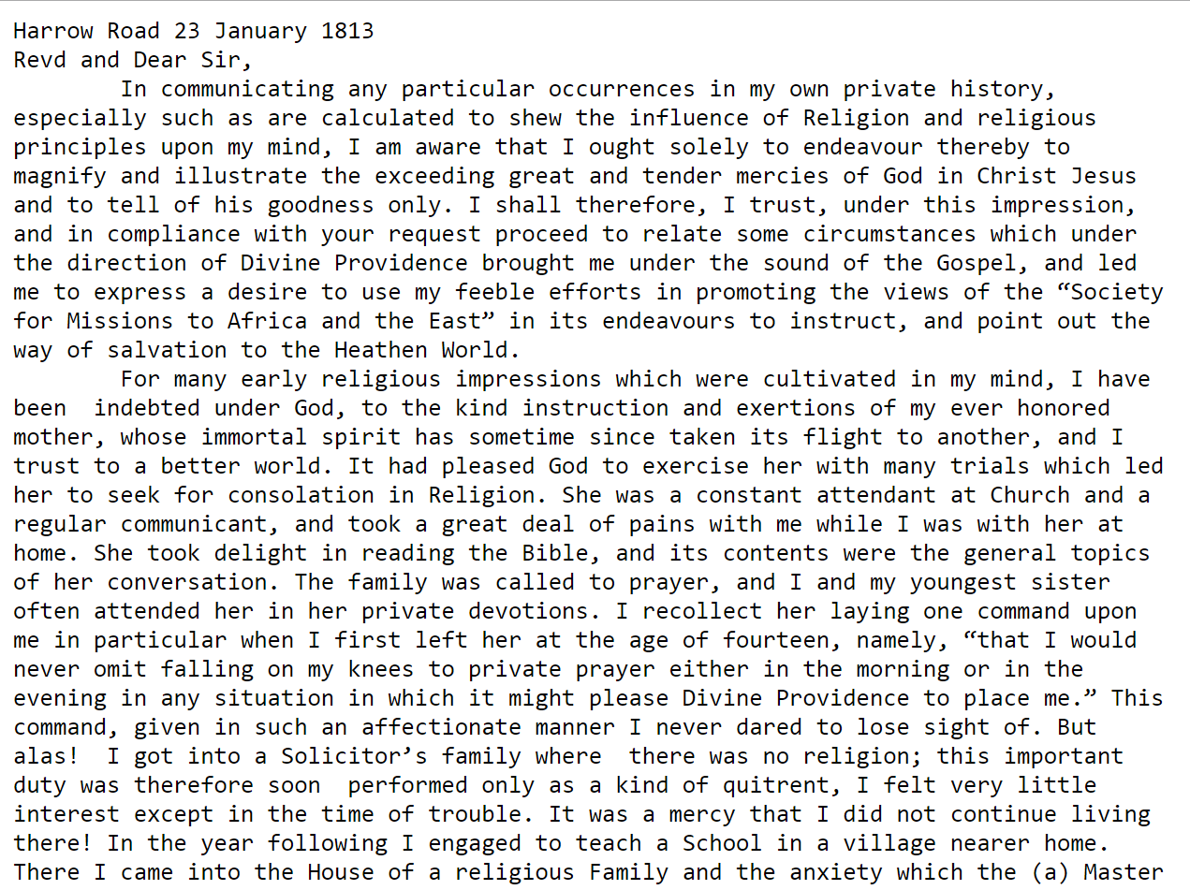

Slide 39
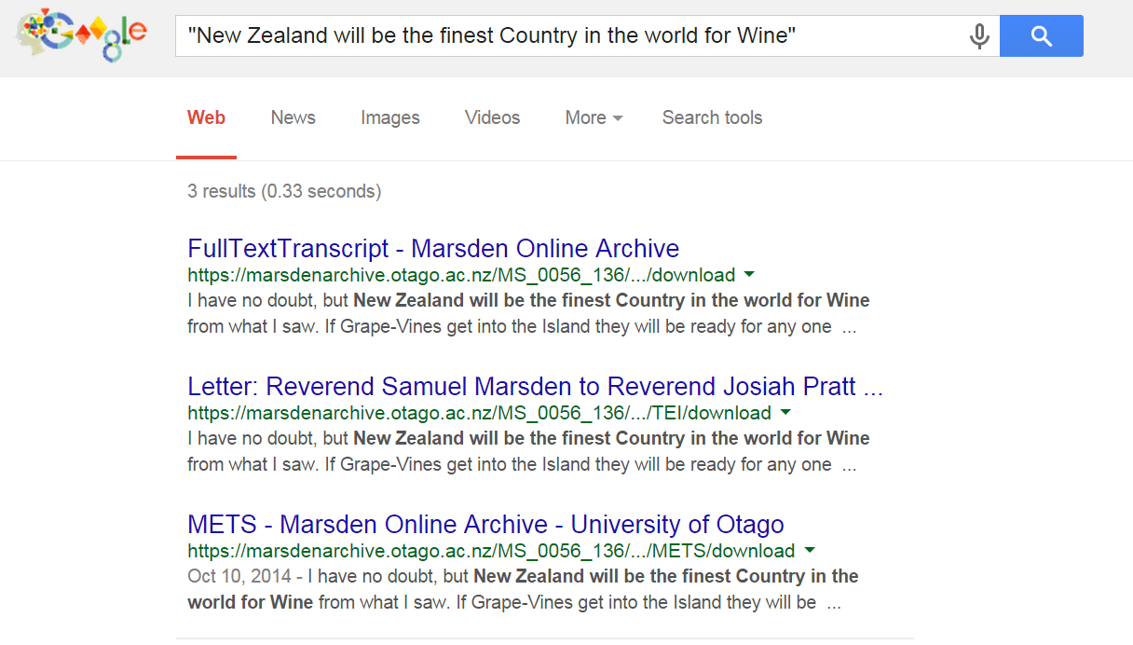

Slide 40
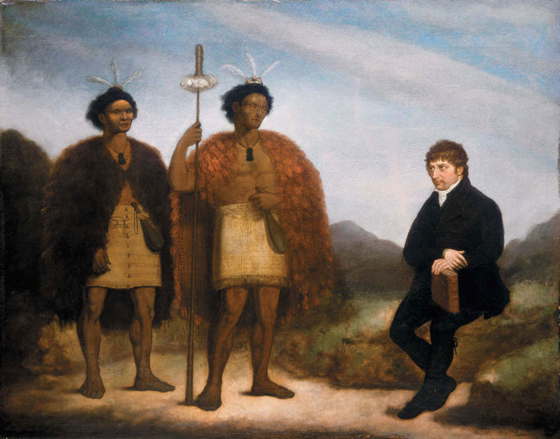
Binney, Judith. 'Kendall, Thomas', from the Dictionary of New Zealand Biography. Te Ara - the Encyclopedia of New Zealand, updated 29-Oct-2013.
http://www.TeAra.govt.nz/en/biographies/1k9/kendall-thomas
Image: Barry, James : [The Rev Thomas Kendall and the Maori chiefs Hongi and Waikato] 1820.
Alexander Turnbull Library ref: G-618. http://mp.natlib.govt.nz/detail/?id=3333

Slide 42
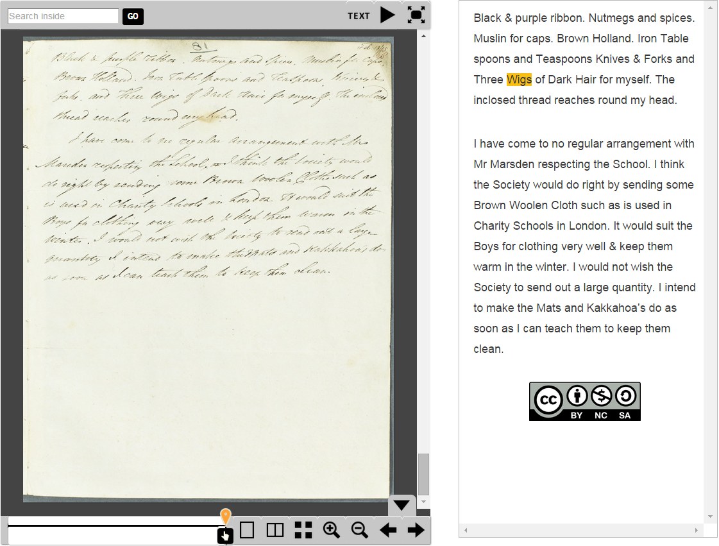
Letter: Reverend Thomas Kendall,
To Reverent Basil Woodd, 13 February 1815.

Slide 43
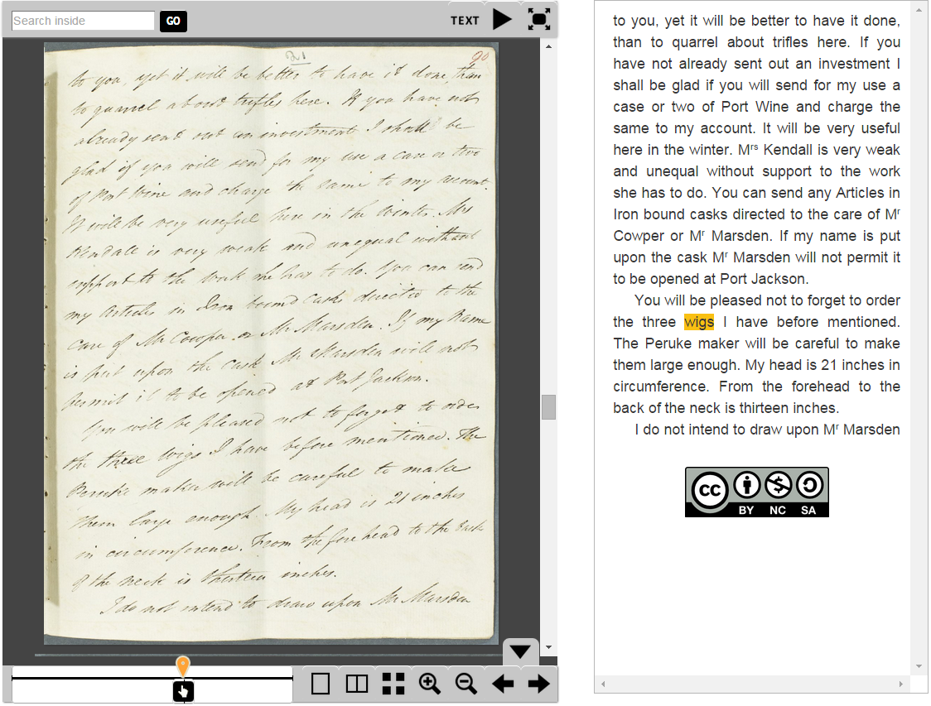
Letter: Reverend Thomas Kendall,
To Reverend Josiah Pratt, 19 October 1815.

Slide 44
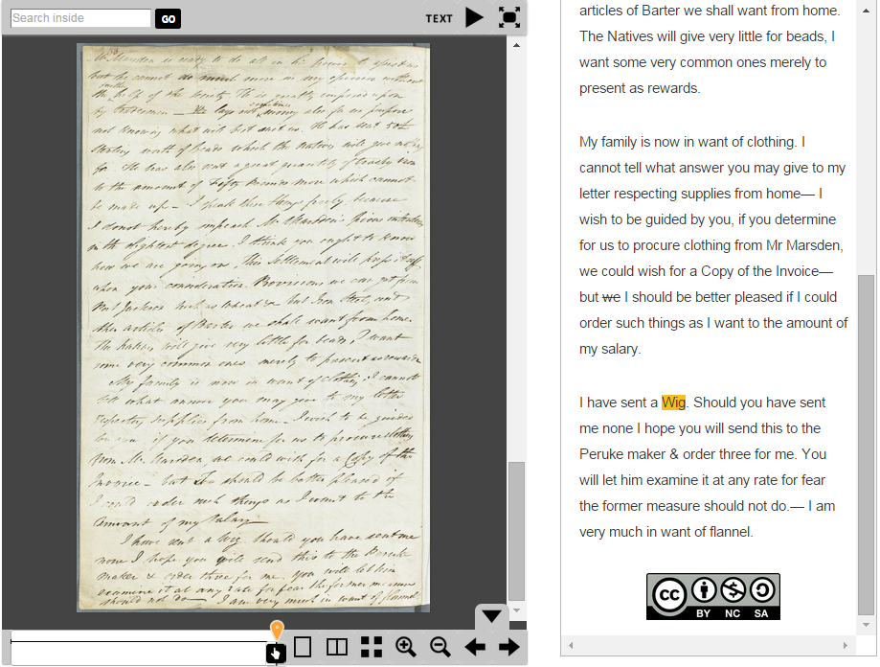
Letter: Reverend Thomas Kendall to Reverend Josiah Pratt, 6 November 1816

Slide 45
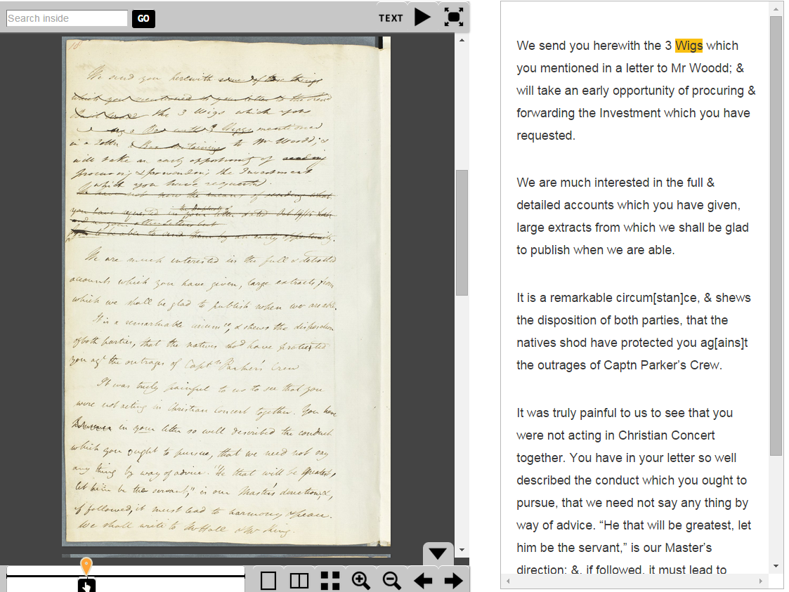
Letter: Reverend Josiah Pratt
to Reverend Thomas Kendall, 7 June 1817.

Slide 46
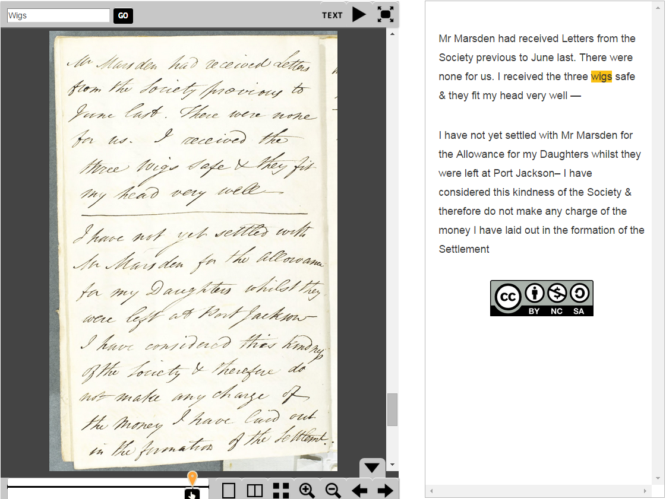
Letter: Reverend Thomas Kendall
to Reverend Josiah Pratt, 8 December 1818.
Notes:
In December 1818, Kendall reports that he has received the wigs, and they fit!
But this letter is not received by the CMS until June the following year (14 June 1819).
(Kendall initially asked for them in February 1815, so you can see how long these things took)

Slide 48
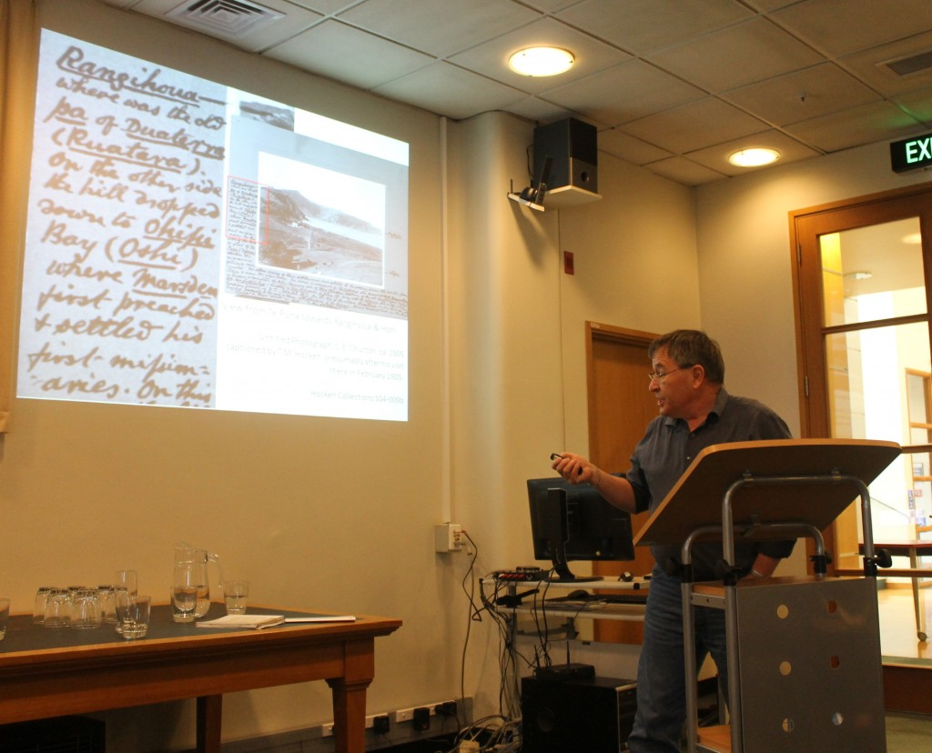
Dialogues: Exploring the Drama of Early Missionary Encounters, co-convened with the Hocken Collections, 7-8 November 2014. Convenor: Tony Ballantyne

Slide 49
Strengthening Relationships
“The Marsden Online Archive brings together the outstanding archival materials of Hocken Collections, excellent transcriptions by Gordon Parsonson, powerful search tools, and a range of contextualising information within a user-friendly interface. It will not only transform how researchers approach the history of cross-cultural contact in New Zealand, but will also allow teachers to immerse their students in a truly compelling and drama-filled set of sources that capture the richness and complexity of the past.”
Notes:
By working closely with researchers to determine their requirements for the archive, the library has strengthened our relationship with them. We have clearly demonstrated the added value that the library offers to the wider university. We have strengthened our relationship with our stakeholders, and found new ways to use the skills and talents of library staff to support our research community. Several research outputs have already come out of the archive.
This project has helped to raise the library profile, by demonstrating that library services are evolving to meet the changing needs of our research community.
By putting our resources online, we are showcasing the unique and nationally significant material available in our collections. Our digitisation is preservation quality, which ensures that this important cultural heritage material will also be available for future generations. As often happens with digitisation projects, Researchers have told us to expect a surge in publications about Samuel Marsden, as they will no longer have to travel to Dunedin to access this material.

Slide 50
Samuel Marsden's First Word Cloud, 'Marsden’s Account of his First Voyage to New Zealand, 20 June 1815, MS 55/4'
Notes:
Tony has used this text to create word clouds, which help to visualise the language of Empire.

Slide 51
National News Coverage
http://tvnz.co.nz/national-news/hocken-library-launches-online-archive-video-6126785

Slide 52
Audience Location (Country)
Notes:
If a user blocks java, they will not be counted. People are staying on the page (see low bounce rate), and exploring deeply (almost 6 clicks, on average).
Country Sessions
New Zealand 4,034
United States 351
Australia 224
United Kingdom 119
Canada 81
Germany 33
Ireland 32
Hong Kong 27
China 19
Netherlands 14
5,063

Slide 53
Notes:
Country Sessions
New Zealand 4,034
United States 351
Australia 224
United Kingdom 119
Canada 81
Germany 33
Ireland 32
Hong Kong 27
China 19
Netherlands 14
5,063

Slide 57
https://marsdenarchive.otago.ac.nz/

