Slide 1
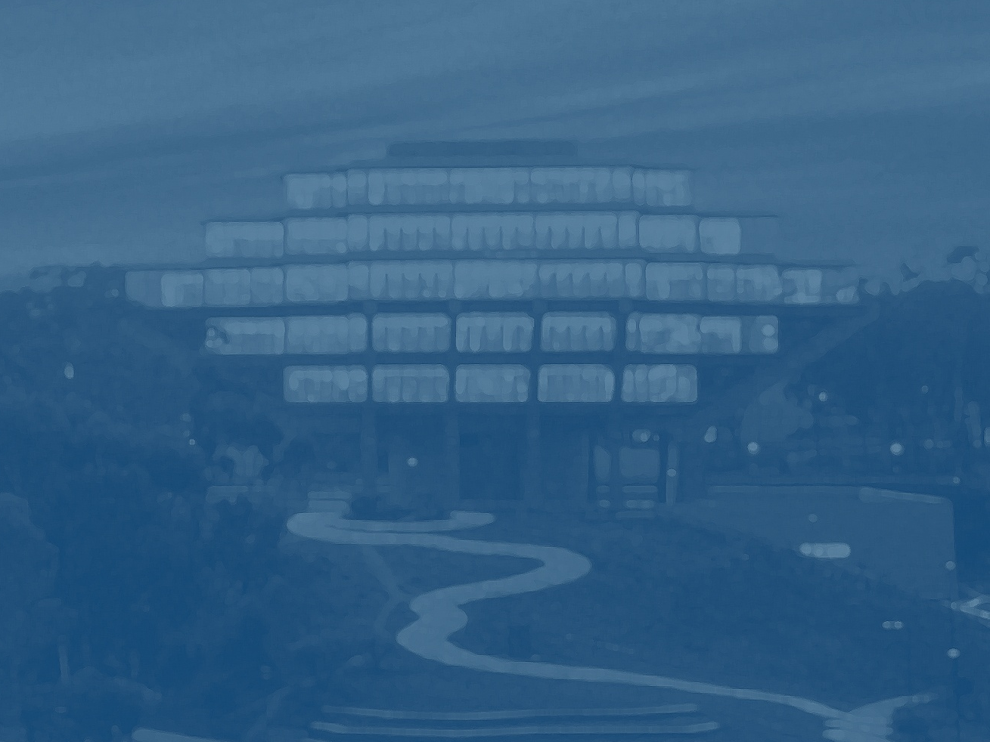
The San Diego Technology Archive
Brian E. C. Schottlaender
The Audrey Geisel University Librarian
University of California, San Diego
PRDLA 2010 Conference
Fudan University, Shanghai
Notes:
Template changed to UCSD Libraries’ PPT template except for screenshots

Slide 2
The San Diego Technology Archive
WHAT IS IT?
An online archive that documents the history, formation, and growth of the companies and affiliated entities comprising the “Technology Clusters” of San Diego
The Archive begins in the year 1965, with an initial focus on three San Diego technology clusters:
    Life Sciences
    Telecommunications
    Software/Information Technologies

Slide 3
The San Diego Technology Archive
WHAT IS ITS INTENDED AUDIENCE?
Academic researchers
Historians
Employees of companies
and investment entities
Other individuals …
… with an interest in San Diego’s business environment for technology and innovation.

Slide 4
The San Diego Technology Archive
WHAT DOES IT INCLUDE?
Brief biographies of San Diego business leaders
Oral histories (audio and transcripts) of those leaders
Interactive timelines illustrating the chronology of San Diego’s technology industries
A graphic representation of the genealogy of companies that constitute the respective technology clusters

Slide 5
The Evolution of Online Oral Histories
From: Sites with text-only transcripts
  LC’s “Born in Slavery: Slave Narratives from the Federal Writer's Project, 1936–1938"
  http://lcweb2.loc.gov/ammem/snhtml/snhome.html
Notes:
I’d consolidate the “What Others Have Done” slides into 1, or 2 at most.
Done. I’ve consolidated the information into two slides and included two quickie screenshots for illustration.

Slide 6
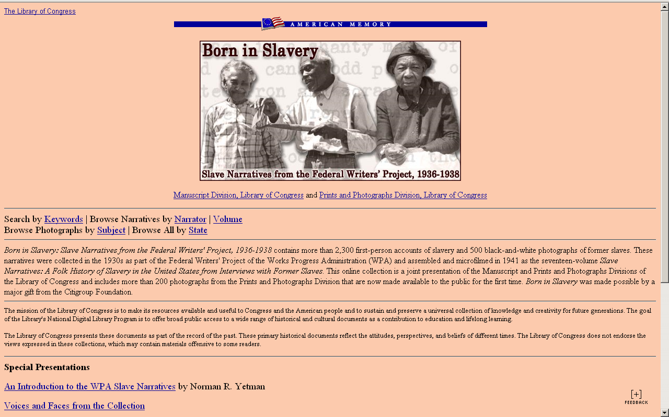

UC San Diego | Libraries

Slide 7
The Evolution of Online Oral Histories
From: Sites with text-only transcripts
LC’s “Born in Slavery: Slave Narratives from the Federal Writer's Project, 1936-1938“
http://lcweb2.loc.gov/ammem/snhtml/snhome.html
To: Sites with limited audio “excerpts”
  University of Southern Mississippi’s "Civil Rights in Mississippi Digital Archive"
http://www.lib.usm.edu/~spcol/crda/oh/adickes.htm
Notes:
I’d consolidate the “What Others Have Done” slides into 1, or 2 at most.
Done. I’ve consolidated the information into two slides and included two quickie screenshots for illustration.

Slide 8
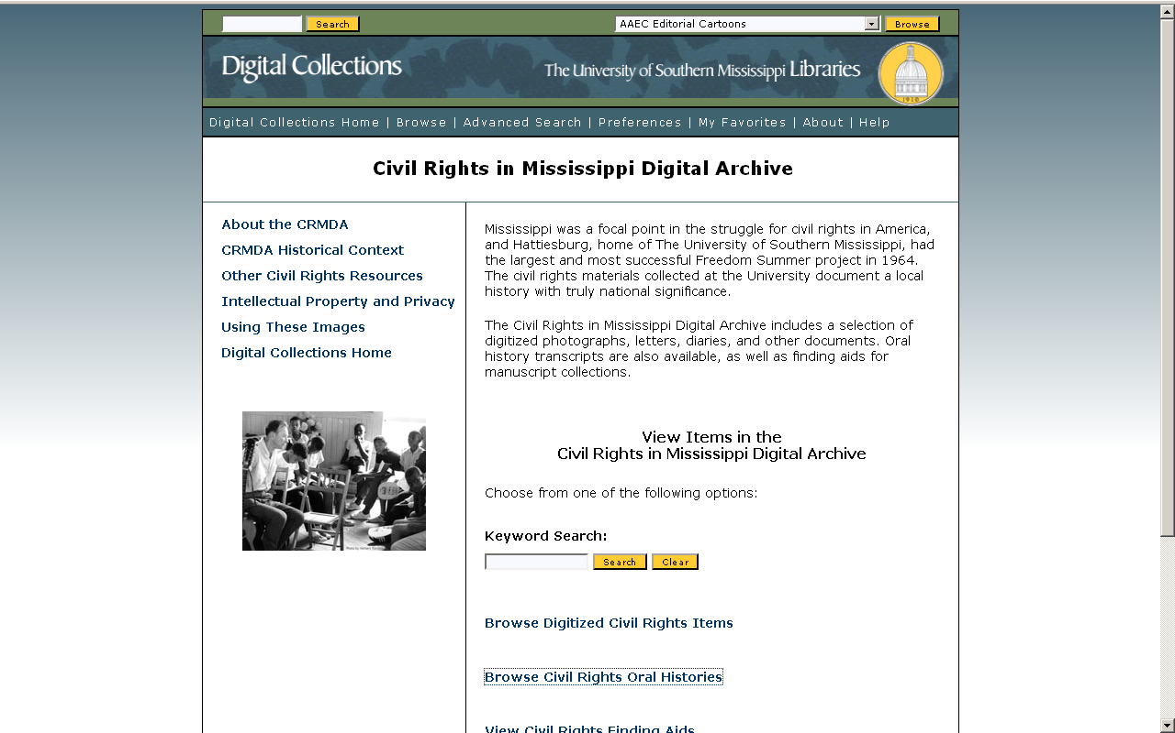
UC San Diego | Libraries

Slide 9
The Evolution of Online Oral Histories
From: Sites with text-only transcripts
  LC’s “Born in Slavery: Slave Narratives from the Federal Writer's Project, 1936-1938"
  http://lcweb2.loc.gov/ammem/snhtml/snhome.html
To: Sites with limited audio “excerpts”
  University of Southern Mississippi’s "Civil Rights in Mississippi Digital Archive” http://www.lib.usm.edu/~spcol/crda/oh/adickes.htm
To: Sites with more multimedia
  UNLV’s “Nevada Test Site Oral History Project”
  http://digital.library.unlv.edu/ntsohp/
Notes:
I’d consolidate the “What Others Have Done” slides into 1, or 2 at most.
Done. I’ve consolidated the information into two slides and included two quickie screenshots for illustration.

Slide 10
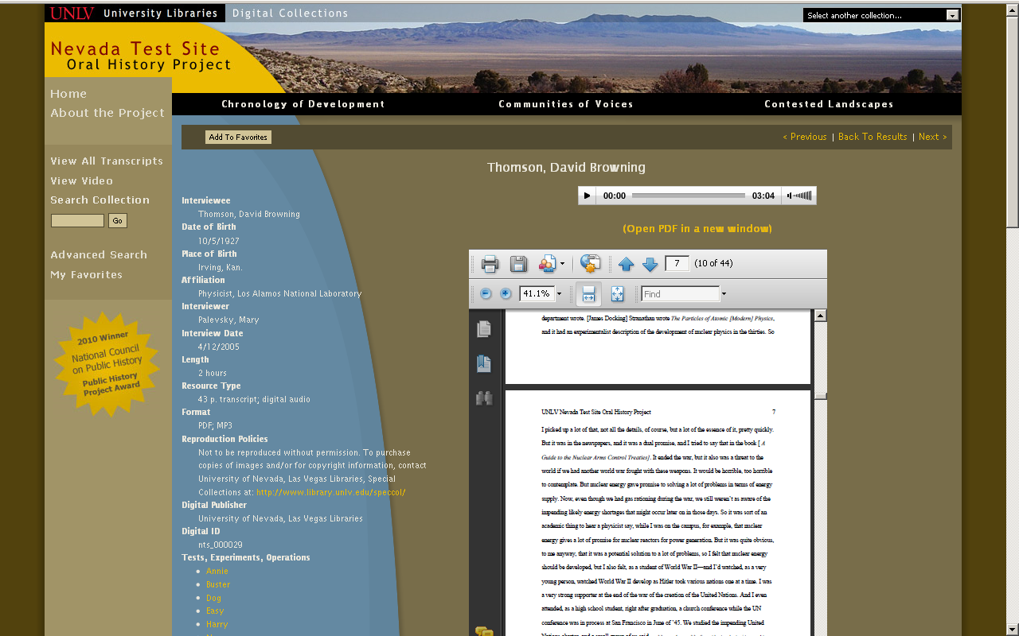
UC San Diego | Libraries

Slide 11
The Evolution of Online Oral Histories
To: The San Diego Technology Archive
    Oral histories reviewed by domain experts for keyword extraction and junction points with other histories
    Audio synchronized with transcript, keywords, timeline
    Interactive and linked timeline
    Integrated links to Web resources
    Corporate genealogy
    Advanced search capabilities
    http://libraries.ucsd.edu/sdta_2/
Notes:
I’d consolidate the “What Others Have Done” slides into 1, or 2 at most.
Done. I’ve consolidated the information into two slides and included two quickie screenshots for illustration.

Slide 12
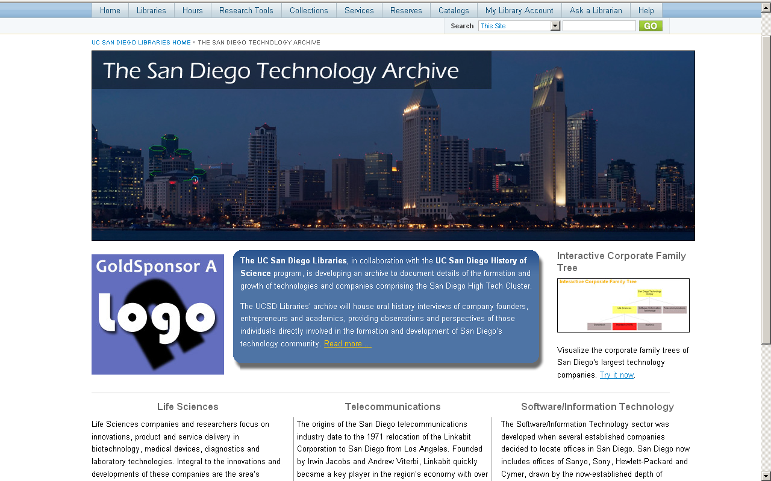
UC San Diego | Libraries

Slide 13
Oral History Player
Audio can be started at any point in the history
  (e.g., 18 minutes and 32 seconds into Dr. Jones’ history)
Mini-biography of speaker
Key facts (“milestones”) are displayed in timeline
List of links to corporations or persons with whom the speaker is associated
Text of transcript will scroll automatically with audio
Hyperlinks to timeline milestones will be synchronized with audio

Slide 14
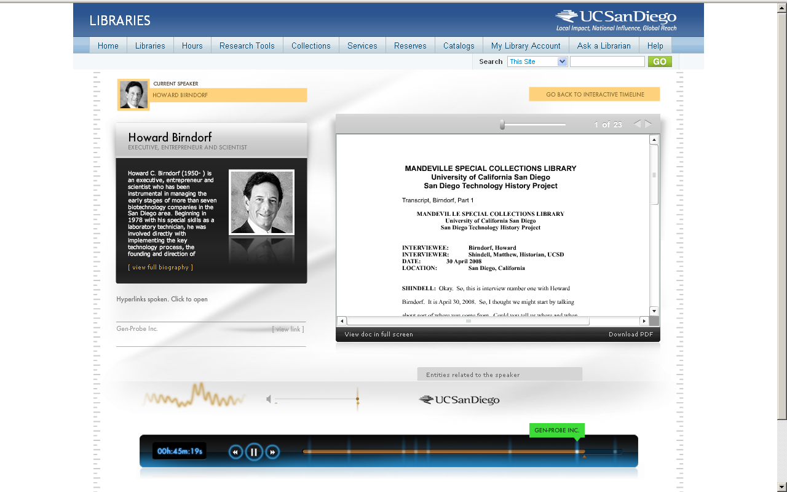
UC San Diego | Libraries

Slide 15
Timeline
Built on key dates extracted from histories by domain experts
Individual speakers can be “added” to the timeline
User can see the whole picture by adding all speakers, or just see one speaker’s timeline
All milestones displayed on the timeline will be linked to the relevant oral history

Slide 16
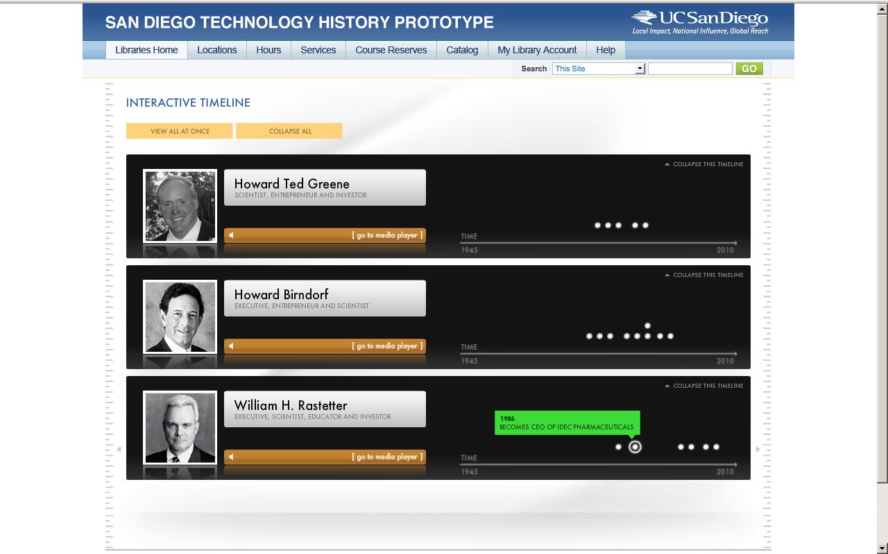
UC San Diego | Libraries
Notes:
Is the title of this slide deliberately different from that of slide 14?

Slide 17
In the Future
Further automate ingest of oral histories
Synchronize oral history audio with transcript
Link timeline milestones to oral histories
Implement advanced search

Slide 18
Search: Existing Implementations
Search for “E. coli genome”
Metadata searched for “E. coli genome”
Results displayed as list of transcripts
for relevant histories

Slide 19
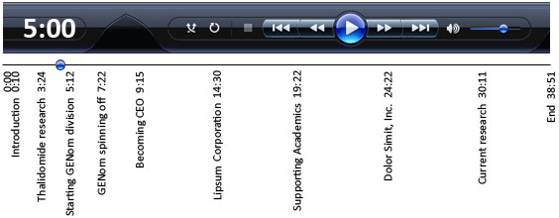
Advanced Search: SDTA
Search for “E. coli genome”
Full text of transcripts searched for “E. coli genome”
Results cued to minute nearest search term
in relevant histories

Slide 20
In the Future
Operationalize ingest of oral histories
Synchronize oral history audio with transcript
Link timeline milestones to oral histories
Implement advanced search
Develop video support
Add photos, video and other multimedia
Link to Technology Cluster sites
  CONNECT
  BIOCOM
Add corporate content
Implement social networking capabilities, including peer-tagging of oral histories

Slide 21
QUESTIONS?

