Slide 1

Transformative Collection Services
Rethinking Library Technical Services for the University of California
R Bruce Miller

Slide 2
Part one: PRDLA 2009 Auckland
Next-Generation Technical Services
  http://www.prdla.org/2009/10/next-generation-technical-services/
an initiative among the University of California Libraries to transform technical services
  to achieve significant cost and labor savings
  to enhance and expand end user access to information resources
  to curate the complete life-cycle of digital information

Slide 3
Part two: PRDLA 2010 Shanghai
Planned: detailed report of outcomes & specific actions
Reality: NGTS a year later
  progress
  lessons learned
  next steps
  but no report with action plans

Slide 4
Original schedule
July 2008 – systemwide discussion paper
January 2009 – formal statement of initiative
  charges to Executive Team & Steering Team
April 2009 – scope statement
July 2009 – charges to Resource Teams
3 Phases:
  research – July-October 2009
  proposals – November 2009-February 2010
  analysis – March-May 2010
June 2010 – implementation
October 2010 – report to PRDLA

Slide 5
Reality schedule: 3 Phases
Phase 1: research
  July-October 2009 August 2009-February 2010
  extensive consultation during research took a lot of time
  vetting of reports was complex and took longer than anticipated

Slide 6
Reality schedule: 3 Phases
Phase 2: develop specific proposals
  November 2009-February 2010 cancelled
  insights from Phase I suggested new strategies
New Phase 2: March 2010-September 2010

Slide 7
Reality schedule: 3 Phases
Phase 3: analysis
  March-May 2010 cancelled
New Phase 3: review for decisions & priorities
  October-November 2010
    after PRDLA 2010 Shanghai
    sorry: no details to share today

Slide 8
what have we learned?

Slide 9
More meaningful vocabulary
next-generation transformative
technical services collection services
  no clear boundary between traditional technical services and traditional collection development and management

Slide 10
Transformation is not easy
Innovative technical actions offer the opportunity to be truly transformative
Technical actions also raise complex social, financial, and political issues

Slide 11
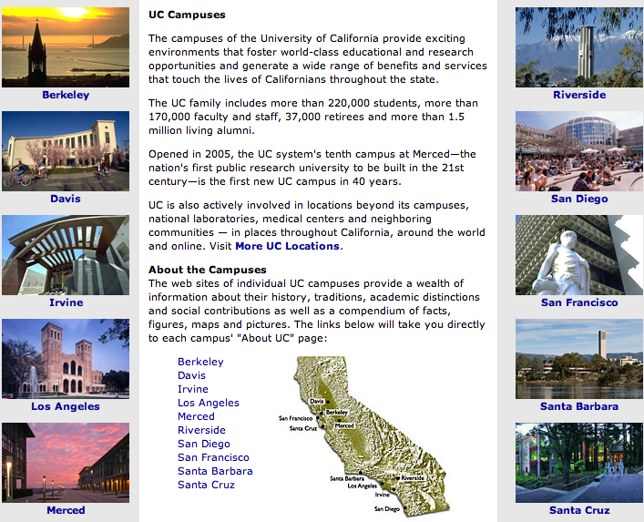
Organizational context

Slide 12
“One University, One Library”
Reality
  Ten campuses and California Digital Library
  Ten University Librarians and Executive Director of CDL
Eleven equal organizations and eleven strong leaders working together voluntarily, with no mandate, as a collaborative collective
Complex and subtle process, relationship, and management issues

Slide 13
NGTS Process: consultation & communication
breadth and depth of expertise on all teams
representation from all stakeholders
exhaustive consultation
  ULs, SOPAG, CDC, HOPS, HOTS, LTAG, RSC, SCO, CAMCIG, ACIG, SCP, PAG, HOSC, UCAC …
communicate, communicate, communicate
  web site and wiki
  listservs, email updates
  campus forums, facilitated group processes
these processes take time

Slide 14
Revised Phase 2 and 3

Slide 15
Phase 2 (revised)
endorsement from University Librarians
  4 specific recommendations to develop detailed proposals for action
  action items in progress

Slide 16
Phase 2: Financial Infrastructure
Develop a financial infrastructure that facilitates intercampus business transactions in support of collaborative and systemwide processes and purchases

Slide 17
Phase 2: Operational Infrastructure
Develop an operational infrastructure and technical services that can function at an enterprise level in support of efficient, non-redundant, and collaborative collection services

Slide 18
Phase 2: New Modes
Redefine baseline information access for materials in non-Roman languages, special collections, archives, and digital formats with the focus on end user needs and effective and efficient processes
Propose new modes for organizing and providing access to these materials
Focus on outcomes that provide access to materials that are currently in cataloging backlogs

Slide 19
Phase 2: Digital Materials
Coordinate NGTS activities with the work of SOPAG and the Collection Development Committee in developing strategies for re-visioning collection development for the 21st century
Ensure that all forms of digital materials are included

Slide 20
Phase 2: work in progress
“obvious” tasks that can and should be done, no need to wait for NGTS decisions
  implement UC systemwide shelf ready services
  eliminate cataloging backlogs for non-Roman materials
  develop requirements and best practices for creating, maintaining, and updating Local Holding Records for serials in support of NGM, SCP, NGTS
  develop protocol for long-term management of URLs

Slide 21
Phase 3: review for decisions and priorities
tension between open communication and need to steer clear of false expectations and premature decisions
PRE-DECISIONAL DISTRIBUTION: FOR UL REVIEW AND DISCUSSION

Slide 22
“Pre-decisional” process
University Librarians individually review proposals with their senior management teams
Systemwide Operations and Planning Advisory Group (representatives from senior management at each campus and CDL) reviews proposals and provides feedback to Council of University Librarians
THEN
Council of University Librarians discusses proposals and determines action

Slide 23
Proposals under review
Task Group | Recommendation | Priority | Stakeholders | Timeframe to Implement | Potential Cost Savings | How Transformative
Financial Infrastructure
F1 | Fund commonly held collections and technical services operations from a central source.. | high | CDC, ULs, HOTS, CDL Acq | long | large | high
F2 | Stable funding for positions doing systemwide work | high | ULs, CDL Acq, SCAP | medium | medium | medium
F3 | Fund Tech Services tools systemwide | high | HOTS, CDC | medium | medium | medium
F4a | Deposit account system for co-invests | high | CDC, ULs, CDL,UCOP | short | medium | medium
F4b | CDL Acq. Pass-through account | medium | CDL Acq | short | low | low
F5 | Secure website for real-time recharge and invoice data | high | CDL Acq | short | low | medium
F6 | Use campus procurement cards | medium |  | short | medium | low
Enterprise Collection Services
E1 | Cloud-based systemwide ILS | high | ULs | long | large | high
E2 | Electronic Resource Management Systems (ERMS) | medium | ULs | medium | large | high
E3 | Database of Record | high | HOTS, CDL | long | large | high
E4 | System-wide and Multi-campus Collection Development Activities | medium | CDC | short | small | medium
E5 | Implement a “good enough” record standard for all of UC | high | HOTS, CAMCIG, HOPS | medium | medium | high
E6 | Define and implement UC-wide Collection Services Centers | high | HOTS, Uls | medium | small | medium
E7 | Expand and adjust the Shared Cataloging Program | high | CDC, HOTS | short | small | high
E8 | Implement HOTS System-Wide Shelf-Ready recommendations | high | HOTS, SCP AC | medium | large | medium
E9 | System-wide historical federal government documents repository | low | GILS, HOTS | medium | small | low
E10 | Eliminate Non-Roman Backlogs | high | HOTS, CAMCIG, CDC | short | small | high
E11 | Reduction of Redundant Serials Management Processes | low | HOTS | medium | large | high
E12 | System-wide Model for Collection Services Staffing and Expertise | medium | HOTS, CDC | medium | small | high
New Modes of Access
NM1 | Implement MPLP principles for processing archival and manuscript collections | high | HOSC, UCAC, HOTS | long | medium | high
NM2 | Streamlined processing with ystemwide adoption of Archivists Toolkit | medium | HOSC, UCAC, HOTS, CDL | short | small | low
NM3 | Systematically digitize high use, high priority collections for access | high | ULs, DLSTF2, HOSC, UCAC, LTAG, CDC, HOTS, CDL Mass Dig | long | none | high
NM4 | Implement a coordinated, systemwide solution for creating and managing digital objects | high | DLSTF2, LTAG, CDL | medium | small | medium
NM5 | Leverage UC3 micro-services across the UC Libraries | high | DLSTF2, LTAG, UC3 | medium | medium | medium
NM6 | Implement a shared processing program for surveying, processing and digitizing collections | high | ULs, UCAC, HOSC | medium | small | high
Yes, I know you can’t read this.
Information about the proposals
under review is not public yet.
PRE-DECISIONAL DISTRIBUTION: FOR UL REVIEW AND DISCUSSION

Slide 24
Very important
Proposals are under review
They are not approved projects or action
They are simply ideas that are under consideration
Outcomes for each proposal will include:
  Yes or No
  If Yes, then priority for action

Slide 25
Financial Infrastructure
business models and processes
  remove barriers between campuses
  better facilitate systemwide purchasing and processing for collections, staff, tools, and services

Slide 26
Enterprise-level Collection Management Services
Enterprise-level = holistic, systemwide processes
Examples
  create a single copy of a bibliographic record for use by the entire system
  adopt a single set of standards and policies
  eliminate duplication of effort and local variation in practice
new tools
transform collection development
transform cataloging practices
transform organizational structures

Slide 27
New Modes: special collections, archives, digital formats
new modes for organizing and providing access in support of total life-cycle curation
more output at less cost
  eliminate backlogs and hidden collections
  provide timely and effective access for the end user
  cost less than existing processes

Slide 28
NGTS public website
http://libraries.universityofcalifornia.edu/about/uls/ngts/
Decisions regarding outcomes & specific actions will be posted in the future

