Slide 1
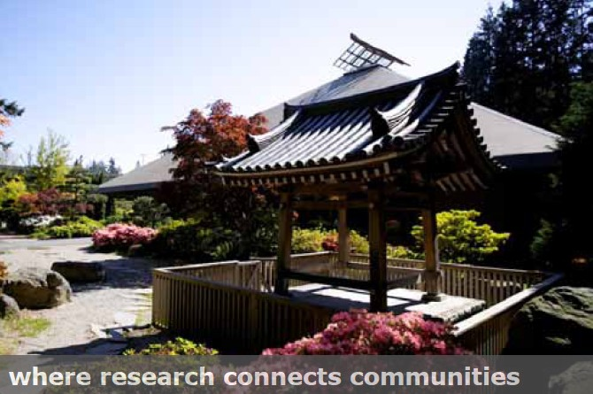
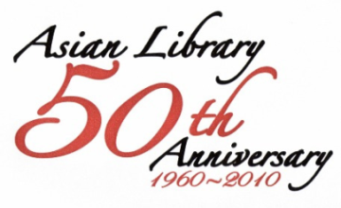
The Digitization of Asian Materials at UBC: A Model for National and International Collaborations
Eleanor Yuen
Asian Library
University of British Columbia October 20th, 2010

Slide 2
Digitization Projects At a Glance (1)
Where research connects communities
The Digitization of Asian Materials at UBC

Slide 3
Digitization Projects At a Glance (2)
Where research connects communities
The Digitization of Asian Materials at UBC

Slide 4
Where research connects communities
UBC Libraries Strategic directions 2010 - 2015
Manage Collections in a Digital Context
Engage with Community
Accelerate Research
Enhance Student Learning
Internationalization
The Digitization of Asian Materials at UBC

Slide 5
Where research connects communities
National Collaboration
Canadian Historical Recognition Program (CHRP)
Partnership and funding model
Build on on-going community engagement
Recognized as a home for Chinese language archival materials
- Previously funded by the Federal government: Multicultural Canada and 2008 CHRP grant
A portal for provincial & local projects: Community empowerment
The Digitization of Asian Materials at UBC

Slide 6
Where research connects communities
National Collaboration
Canadian Historical Recognition Program (CHRP)
Partnership and funding model
Partnership with faculty, regional / local organizations, other knowledge organizations, archivists at UBC and beyond
Collaboration with digital initiatives, archival collections, institutional depository and cataloguing workflow
- Funding from Citizenship and Immigration Canada which supports projects about historical wartime measure or immigration restriction:
Second World War Internment of Italian-Canadians
Head Tax or other Immigration restrictions experienced by the Chinese Canadians
Komagata Maru / Continuous Journey clause that affected the Indo-Canadian community
The Digitization of Asian Materials at UBC

Slide 7
Major Challenges
Where research connects communities
Participating community groups have:
Cloudy concept of copyright
Little knowledge of digitization process
Need handholding in meta data mining
Reluctant to share files
Asian Library needs to:
Revisit the archival collection policy
Negotiate hosting site

Slide 8
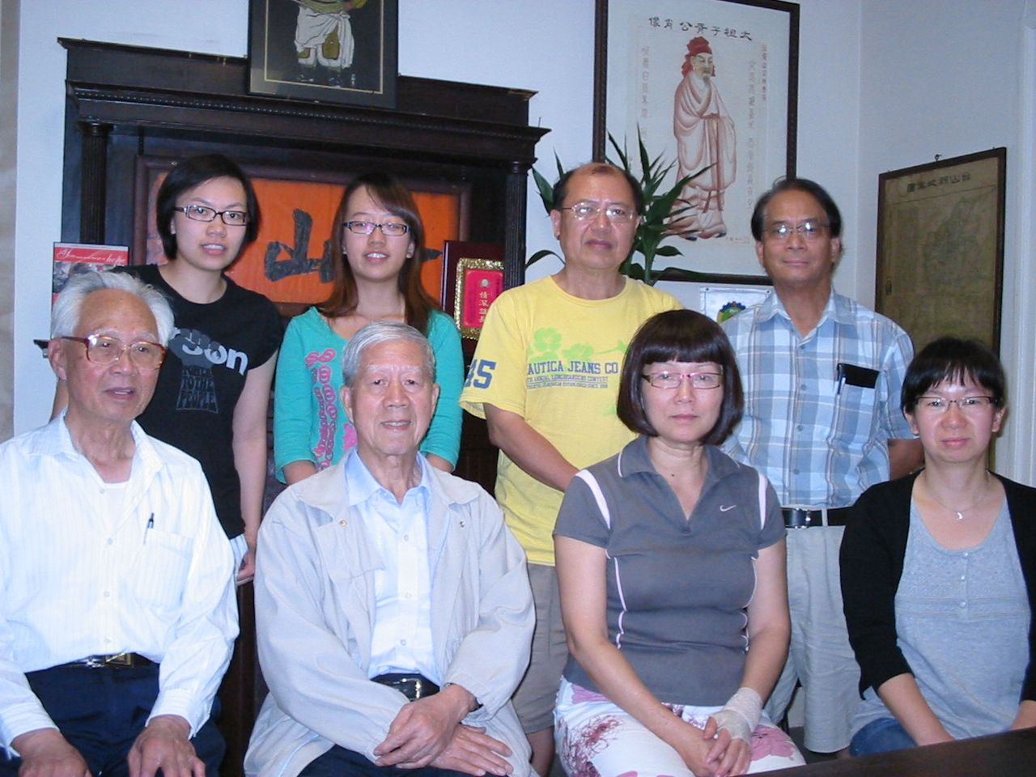
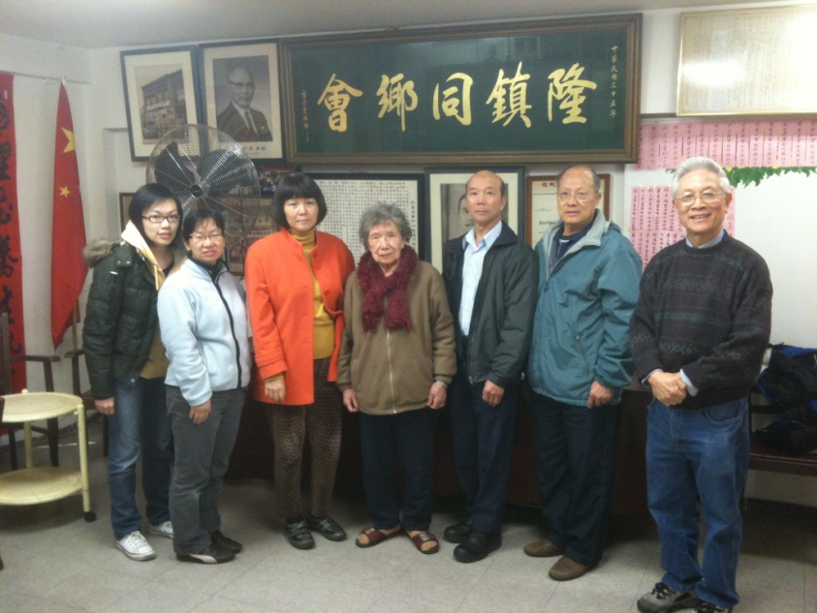
Where research connects communities
Head Tax Mapping Project:
How We Tackled The Challenges:
Work with Members from Taishan and Zhongshan Communities
Useful Resources from The U.S. Site: http://www.fas.harvard.edu/~chgis/
Data Clean-up: UBC Student Projects
The Digitization of Asian Materials at UBC

Slide 9
Where research connects communities
Added Value of This Project
For the Public:
Help identify Genealogy and Ancestors from The Records
For Researchers and Students:
Establish Broader Social Landscapes of Chinese Immigration in Canada
eg: Compare the Head Tax Paid with the Cost of Living in Canada
For Library:
Promote the Use of Collection for Five County Area (五邑) Gazettes
International Collaboration opportunities with
UCLA, UC Berkeley, WILCOS, & Find Your Roots Program
The Digitization of Asian Materials at UBC

Slide 10
Where research connects communities
Finding: Head Tax Fee Paid by Taishan Immigrants
N=44,131
16,123 Taishan immigrants paid 500 dollars for the Head Tax Fee;
15,013 paid 50 dollars;
6,932 paid 100 dollars;
1,969 paid 0.5 dollars.
The Digitization of Asian Materials at UBC

Slide 11
Where research connects communities
Finding: Head Tax Fee Paid by Zhongshan Immigrants
N=5,899
2,873 Taishan immigrants paid 500 dollars for the Head Tax Fee;
1,461 paid 50 dollars;
943 paid 100 dollars;
126 paid 0.5 dollars.
The Digitization of Asian Materials at UBC

Slide 12
Where research connects communities
National Collaboration
The Korean Canadian Heritage Archives Project
Partnership and funding model
Project Partner – Cheng Yu Tung East Asian Library, Univ. of Toronto, Canada
Objectives – collect publications on Korea and Koreans published in Western Canada
At the local level – work with faculty, regional / local organizations, families and individuals
Work in tandem with the Korean Collections Consortium of north America (KCCNA)
Funded by a local bank in Vancouver
The Digitization of Asian Materials at UBC

Slide 13
Where research connects communities
International Collaboration
The Digitization of Chinese clan association publications
Partnership and funding model
Project Partner – Genealogy Society of Utah
Objective – provide on-line access to 5,600 pages of scanned images of local publications which are not readily available outside southern China
Also work with local publishers in southern China and families and individuals in Vancouver
GSU did the scanning on-site at UBC with their own equipment; UBC acted as content-provider
The Digitization of Asian Materials at UBC

Slide 14
Major Challenges
Where research connects communities
International partners have:
- Different concept of copyright vs. ownership
- Legal counsel’s requirement for agreements & MOUs
Asian Library needs to:
- Revisit the archival collection policy
- Investigate choice for access software for Asian materials
CONTENTdm, DSpace, OJS
- Do due diligence to protect fragile materials, authenticate rare items
- Identify expertise and technical skills such as contextual information,
historical background or other similar digital projects
- Identify Institutional repositories for hosting

Slide 15
Where research connects communities
The End
The Digitization of Asian Materials at UBC

