Slide 1
Deciding on a Discovery Tool Making Wise Choices in a Digital Age WeIHUA Shi 2010.10

Slide 2
outlines
Concept of discovery tools
Technical models about Discovery tools
Comments from Students and librarians
How to make wise decision

Slide 3
Concept of Discovery tools

Slide 4
Concept : Discovery Tools
Card Catalogs
databases
Online searching
Federated Search
Discovery service
Nature:
Databases of knowledge: organized the information
Tools or serves to find library resources

Slide 5
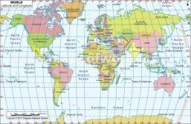
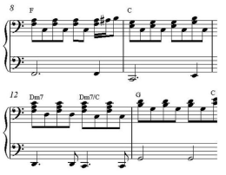
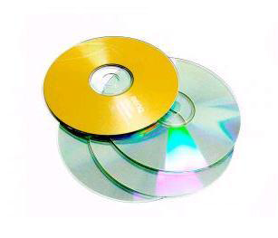
Concept : Background

Slide 6
Concept Description
A Discovery Service is a search interface for pre-indexed meta-data and full text documents. It is different from a federated (or integrated search) in that it does not do a search from live sources, so it is much faster. Discovery services usually have faceted searching capabilities, making it easier to narrow results.

Slide 7
Characters of Discovery Tools
Compelling user interface
Single search across multiple types of metadata
Represent all of the library’s collections
Fast
Intuitive
……

Slide 8
Technology Models
Federated Search
Discovery layer
Web Scaled Service
Hybrid Solutions

Slide 9
Federated Search Model
Limited Results set
Databases
DB1= 20 out of 2,198 available
DB2= 30 out of 6,950 available
DB3= 20 out of 831 available
DB4= 10 out of 179,430 available
DB5= 0 results (broken connector)
DB1
DB2
DB3
DB4

Slide 10
Discovery Layer
MARC Records
Discovery layer: Web 2.0 features
Discovery layer: faceted searching-clustering and cloud tools

Slide 11
New Discovery Tool
……
Subscribed information
publisher1
Central Index
Platform
publisher3
Local Collection
publishers
Patrons

Slide 12
Hybrid Solution
Hybrid Results
Results are always biased toward what is in the index from the vendor
Federated Sources
DB1= 20 available
DB2= 30 available
DB3= 20 available
DB4= 10 available
DB5= 0 results (broken connector
DB1
Centralled
Index
DB2
DB3
DB4
DB5

Slide 13
Discovery Products Analysis
Summon
EBSCO DicoverySolution
WorldCat Local
Primo

Slide 14
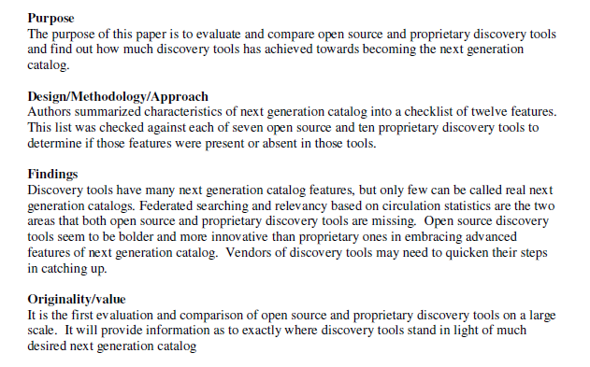
Comparing Discovery Tools

Slide 15
What I concern and investigate
Difference of Metadata mapping
Contents they provide

Slide 16
Summon: Web-Scale true Discovery

Slide 18
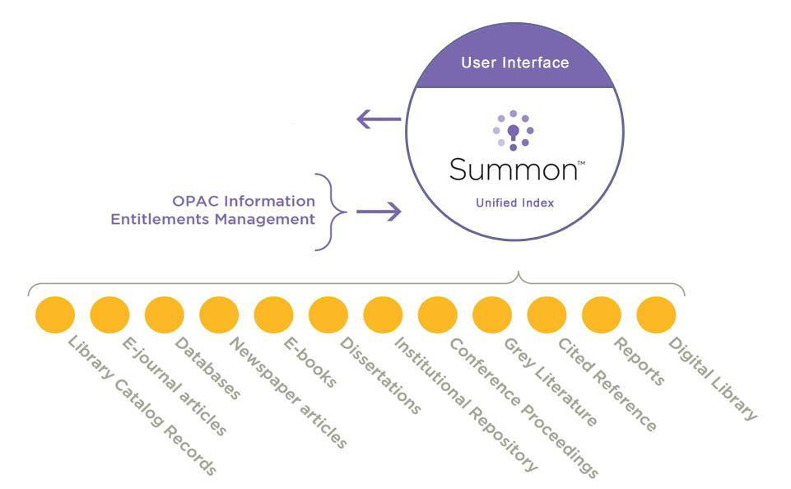
What Makes It Web-Scale Discovery?
•One stop shop for the library’s resources
•Search everything with one click
•Simple. Easy. Fast
•Find relevant results regardless of content provider
•No need to sift through unfamiliar database names

Slide 22
Summon
More than 100 Customers have Discovered the Summon Difference The Summon TM web-scale discovery service recently marked the milestone of serving 100 client libraries in just over a year since its commercial launch. Although they span 16 countries, these libraries enjoyed typical set-up times of 6-8 weeks

Slide 23
WorldCat Local

Slide 24
OCLC: WorldCat Local
Membership 7,2000 from 171 countries
WorldCat is a global network of library-management and user-facing services built upon cooperatively-maintained databases of bibliographic and institutional metadata.
ILL : easy to share
from cataloging to resource sharing to discovery and delivery—by intelligently reusing contributed data, and makes library resources more visible on the Internet by distributing data across a growing number of partner services and Web technologies.

Slide 25
EBSCO Discovery Solution
EBSCOhost databases are the most-used, premium online information resources for tens of thousands of institutions worldwide, representing millions of end-users.

Slide 26
EBSCO Discovery Solution
A single, simple entry point customized for each library
"Local" access to more than 35,000 journals and magazines and, from WorldCat, 130 million books, videos, and music CDs
Up to 330 databases available via EBSCOhost (loaded locally), including Academic Search, Business Source, ATLA Religion Database, CINAHL, ERIC, Historical Abstracts, MLA International Bibliography, PsycINFO, and many more
A discovery layer service that enables users to search a wide-ranging collection of metadata and link quickly to the content to which they have rights
Metadata and seamless linking to e-journals from more than 400 publishers
Other partners (to be announced)

Slide 27
Cooperation between OCLC and EBSCO

Slide 28
Primo
From Ex Libris
Ex Libris Group is a leading provider of library automation solutions, offering the only comprehensive product suite for the discovery, management, and distribution of all materials.

Slide 29
Stay tuned
Winner?

Slide 30
They have made decision
Primo 275 patrons
Summon celebrate its 100 patrons

Slide 31
React from Chinese Librarian
Purchasing
Shanghai JiaoTong Universtity: Primo
Investigate, Wait and See
Tsinghua Univ.
Peking Univ.
Fudan Univ
……

Slide 32
Summon: Comments from UNC
North Carolina:
We missed Federated Search tool.
2009 we purchased Summon.
Summon is the only product in the market. It is convenient easy fast research tools.
Undergraduate students love it.
However most graduated student and faculty still go to the way they are used to.

Slide 33
Summon: Comments from Rollins
Focus on full text articles
Ability to refine and limit
Ability to expand beyond Rollins
Clean interface
Serial solutions

Slide 34
Primo: Comments from BYU
We want ProQuest in Primo Central
Relevancy Ranking needs occasional adjusting

Slide 35
Sum up
Discovery tools is welcomed by our patrons.
No perfect products.
Vendors learn from one another and leverage their skill sets to improve discovery tool.

Slide 36
Make a choice?

Slide 37
My suggest
Financial
Understand your patrons and their need.
Content and subject relevant.
Make good use of discovery tools in align with information literacy education.

Slide 38
Thanks! Comments?

